Slide 1
PSHE and Citizenship
Health and Wellbeing | Growing Up
PSHE and Citizenship | UKS2 | Health and Wellbeing | Growing Up | Changing Emotions | Lesson 2

Slide 3
LI
I can describe how thoughts and feelings may change during puberty and suggest how to deal with those feelings.
Success Criteria
I can use scientific vocabulary when talking about puberty
and changes.
I can discuss the emotional changes I might experience and I know what to expect.
I know where to get help and advice if I need it.
This resource is fully in line with the Learning Outcomes and Core Themes outlined in the PSHE Association’s Programme of Study.

Slide 4
The Big Questions

Slide 5

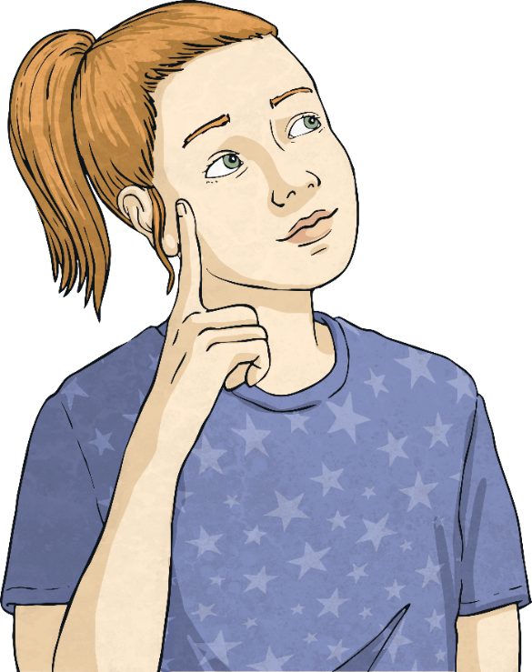
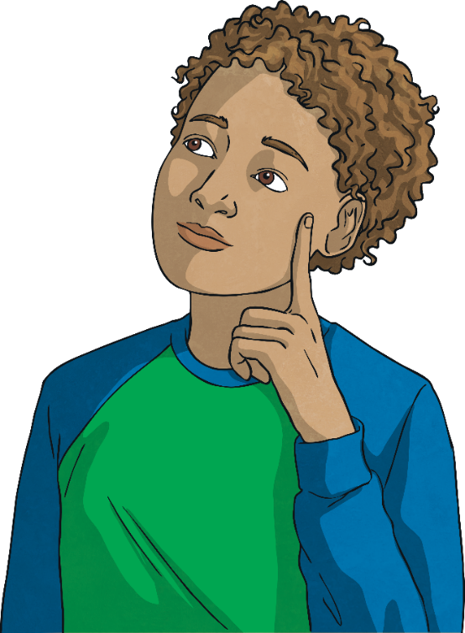
How might our thoughts and feelings change during puberty?
How can we deal with difficult feelings and moods?

Slide 6
Reconnecting

Slide 7

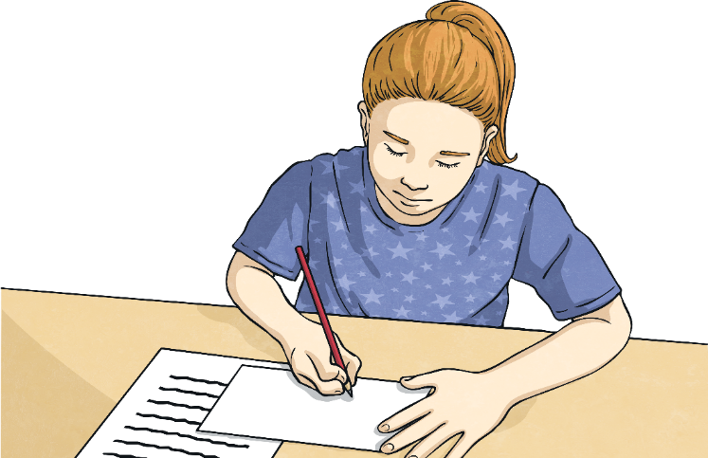
Changing Emotions
Today, we will be learning about how people’s feelings and emotions may change as they go through puberty – a time of change in all young people’s lives.
With your talk partner, list the range of feelings and emotions you think people might experience during puberty.
Think about why young people might be feeling these emotions.

Slide 8
Exploring

Slide 9


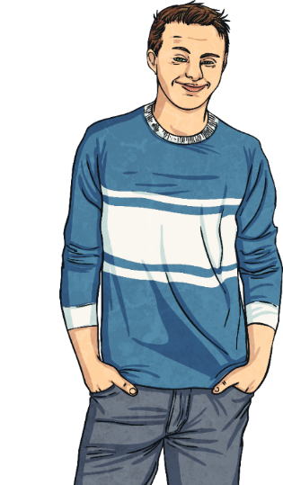
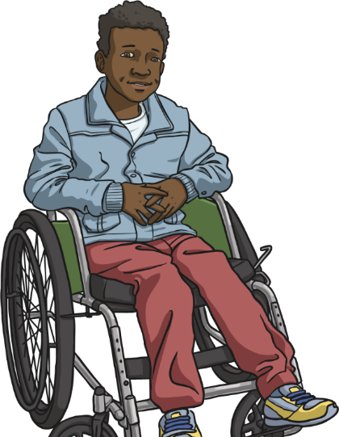

How Emotions Can Change
What is puberty?
Puberty is the word used to describe the phase when a child’s body starts to change as they become an adult. Apart from when you were a baby, this is the time when your body will grow the fastest.
We have already learnt about the physical changes we can expect to see during puberty, but what about the emotional changes?

Slide 10
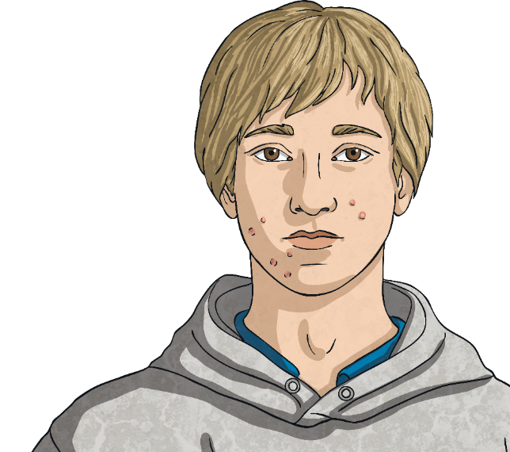
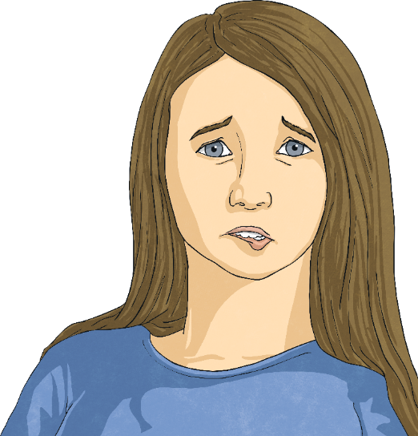
How Emotions Can Change
Puberty can be a confusing - even worrying - time for many young people. That’s why it is important to understand what is happening to your body and to know where to get help or advice if you need to.
It may feel like you are the only person going through these emotions and that nobody else understands how you feel, but that isn’t true. Puberty happens to everyone!

Slide 11

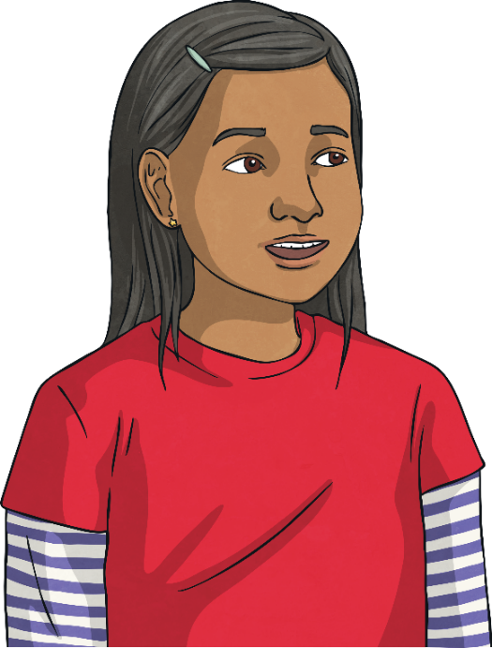
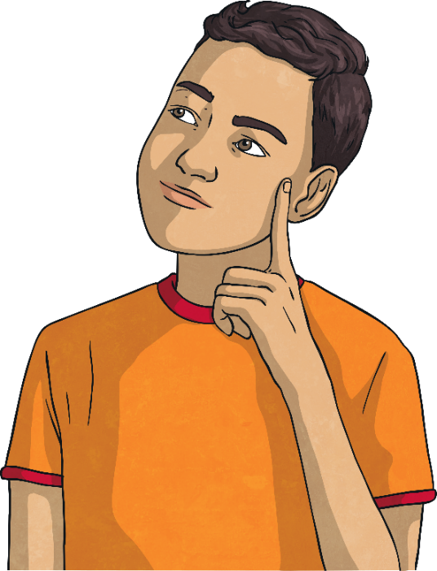
How Emotions Can Change
Let’s read about some children who are experiencing new or difficult emotions as their bodies change and develop.
On the following slides are some letters written to a problem page website.
Think about what advice you could give the young people who wrote these letters or what you might do if you were them.

Slide 12
How Emotions Can Change
Hello,
I am a bit embarrassed about this, but I hope someone can help.
I really, really like this boy in my class. I get strange feelings whenever I see him, like I am excited and a bit sick at the same time. I think about him loads and sometimes dream about him.
It’s so weird because I have known him for ages and he has always been my friend. I never used to feel like this around him and it’s really awkward. I get nervous every time he talks to me!
I can’t talk to my friends because I think they’ll make fun of me, or (even worse) they might tell him and that would be awful!
Please help! What should I do?

Slide 13
How Emotions Can Change
Hi,
I’d really like some advice, please. I have been feeling angry all the time and I don’t know what to do. I keep losing my temper at home with my parents and especially with my younger brother. No one understands how I feel and I just keep getting into trouble. I have also started to get really angry at school and got in a fight the other day.
I don’t feel like myself. I never used to get angry all the time. I feel out of control and I am worried that I will hurt someone or get into big trouble soon.
Any advice please?

Slide 14
How Emotions Can Change
Hey there,
I’m hoping someone might have some advice they can give me, as I am desperate and have no one to turn to. Lately, I have been feeling really, really down. I keep crying all the time and feel so lonely. Often, I don’t even know why I am so down. I have started staying in more, rather than going out with my friends, just in case I cry in front of them or make them miserable, too.
But now I feel so lonely and sad. Everyone else seems so happy. I have no real reason to be feeling down. Things at home are fine and I’m doing OK at school.
Why do I keep crying all the time?

Slide 15
How Emotions Can Change
Please, please, can someone help?
I am drowning in school work and I just don’t know what to do.
The workload has increased and the pressure is all too much. Every lesson, I struggle to keep up and every day I have loads of homework. Sometimes I don’t get anything done because I just don’t know where to start. I sit there looking at it and just feel overwhelmed. Then I have to make up excuses at school about why I haven’t brought my
homework in.
I don’t want to look like a failure – everyone else seems to be coping just fine. But I am getting further and further behind.
What can I do?

Slide 16

How Emotions Can Change
During puberty, feelings can seem more intense and they can change rapidly. These are called mood swings. One moment, you might feel excited about something, then suddenly, something upsets you and you feel super angry!
It’s normal to feel out of control of your emotions and to feel confused by them. During puberty, you’re kind of in between a child and an adult. This means you might experience conflicting emotions, stuck between wanting to be independent and grown up and wanting help - or even just a cuddle!

Slide 17

Questions and Answers
You probably have lots of questions about how and why your emotions may change and where you can go for help.

Slide 18
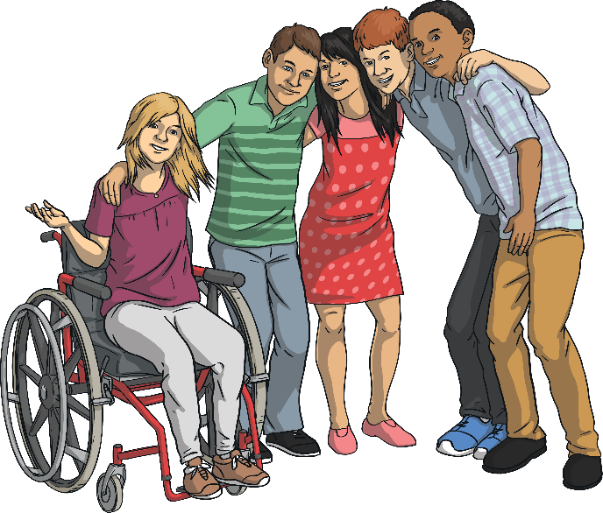
Questions and Answers
Why do these emotional changes happen?
Changing moods and strong emotions during puberty happen to everyone. They are caused partly by the many changes and challenges that happen when you are growing up; at home, at school, in your bodies and in the way you think and act. Times when there are lots of changes in your life can make you feel unsettled and unsure about yourself.
Hormones are also partly responsible for the emotional changes you might feel. Hormones are chemical messengers inside our bodies. Different hormones have different jobs to do and control different things in our bodies, ranging from hunger and sleep, to growth and stress levels.
Certain hormones start to be produced during puberty to help our bodies to grow. These new hormones can make us feel different or strange. They can affect our mood as our body gets
used to them.

Slide 19
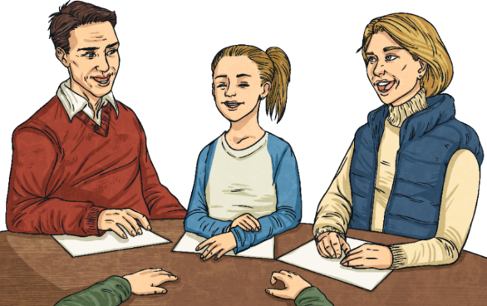
Questions and Answers
Is it normal to feel this way?
Everyone goes through these changes. Some people will be affected by their hormones more than others and people may be affected in different ways. There is no right or wrong way to feel but it is important to remember that you are not the only person feeling the way you do. Changing emotions are a normal part of growing up.
However, just because it is normal to feel changes in your moods when you are growing up, it doesn’t mean that your feelings are not important. If you are feeling like you can’t cope with your strong emotions, or if you feel angry or unhappy a lot of the time, it is important that you talk to someone you trust.

Slide 20

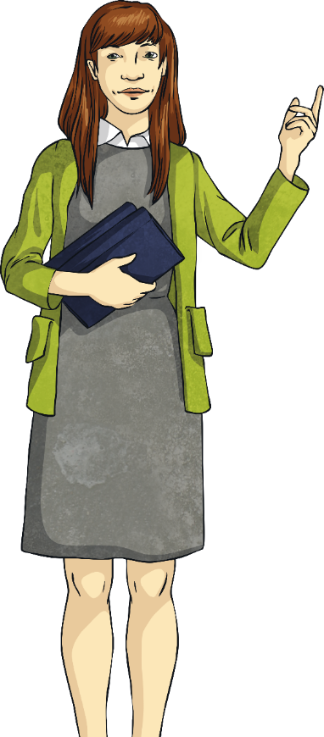
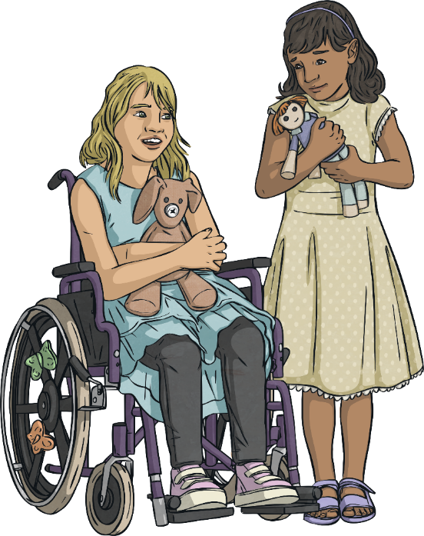

Questions and Answers
Who can you go to for help?
Talking to friends you trust can be a great idea. It will probably turn out that they have had similar feelings.
Try talking to people you live with - this could be your parents, or maybe an older brother or sister. They were your age once and probably remember going through the same emotions.
Is there an adult at school you can trust?
They could listen to you and give advice.
Talk to health professionals, such as your doctor or nurse, or use health websites, such as the NHS, to get advice and support.

Slide 21
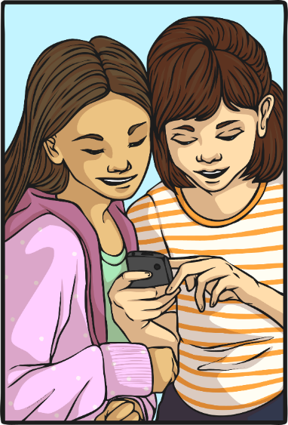
Questions and Answers
What is Childline?
Childline is a free, private and confidential service that offers young people support and advice with any issues that they are going through.
You can call Childline at any time for free on
0800 1111, send them an email, or post on
their online message board.
There is always someone available to help.
No problem is too big or small.
Childline is a ‘confidential’ service. This means
that they won’t tell anyone else that you have
contacted them.

Slide 22

Questions and Answers
Any other questions?
Don’t forget that you can write your questions down and put them in the ‘Question Box’ if you would prefer.
Consolidating
Reflecting

Slide 23
Consolidating

Slide 24


Giving Advice
Choose one of the problems that was sent in to the problem page website.
Think carefully about the advice you would give to that child and how you could reassure them that what they are going through is normal.
How can you explain about hormones and where will you tell them to go
for support?

Slide 25
Reflecting

Slide 26
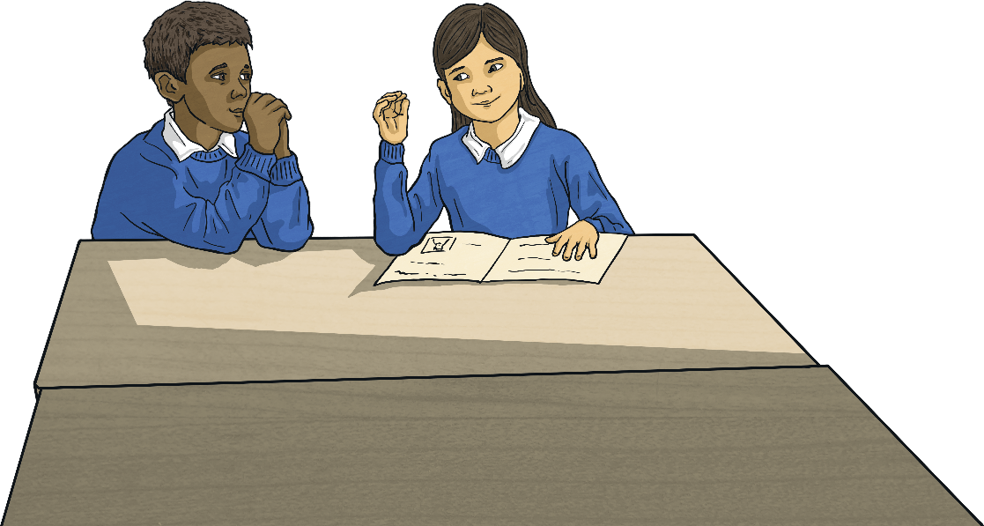
Think of Three…
Work with a talk partner.
Think of three emotions people might feel during puberty.
Think of three words to describe these emotions.
Think of three things that you could do to help yourself if you are upset or confused by these
new emotions.

Slide 27
The Big Questions

Slide 28
How might our thoughts and feelings change during puberty?
How can we deal with difficult feelings and moods?
What was the most important thing that you learnt today?

Slide 29
LI
I can describe how thoughts and feelings may change during puberty and suggest how to deal with those feelings.
Success Criteria
I can use scientific vocabulary when talking about puberty
and changes.
I can discuss the emotional changes I might experience and I know what to expect.
I know where to get help and advice if I need it.
This resource is fully in line with the Learning Outcomes and Core Themes outlined in the PSHE Association’s Programme of Study.

