Slide 1

PSHE and Citizenship
Growing Up | Our Bodies
PSHE and Citizenship | KS1 | Health and Wellbeing | Growing Up | Our Bodies | Lesson 1

Slide 3
LI
I can name the main parts of the body.
Success Criteria
I can use the scientific names for parts of the body.
I can name similarities and differences between different people’s bodies.
I can identify private body parts.
This resource is fully in line with the Learning Outcomes and Core Themes outlined in the PSHE Association’s Programme of Study.

Slide 4
The Big Questions

Slide 5

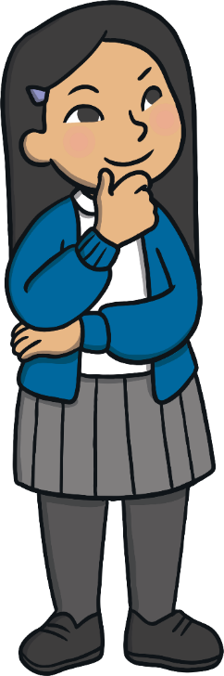
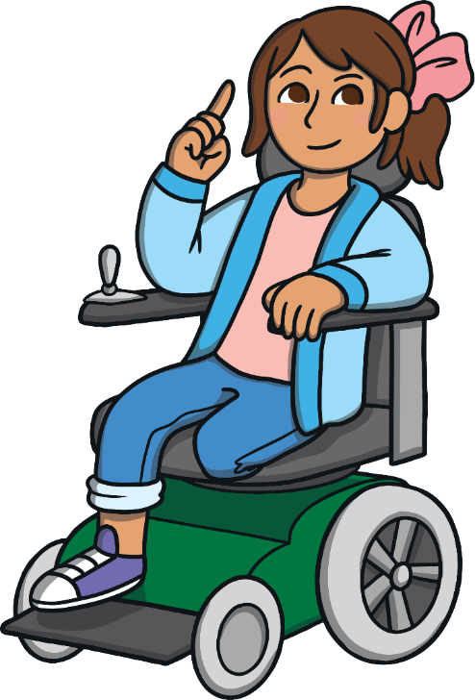
What are the main parts of our bodies?
Which body parts are private?

Slide 6
Reconnecting

Slide 7

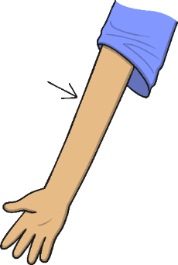
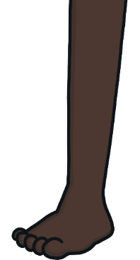
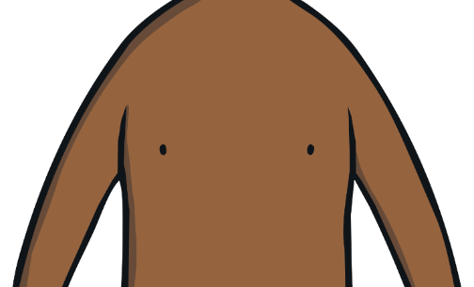
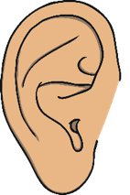
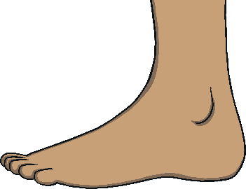
Our Bodies
Let’s play ‘Simon Says’!
When ‘Simon Says’ touch a part of your body, you should touch that part of your body. For example, 'Simon says touch your nose' means you should touch your nose!
But if Simon doesn’t tell you what to touch, you don’t touch it. For example, 'touch your ear' means Simon didn't tell you to do it, so don't touch your ear!

Slide 8


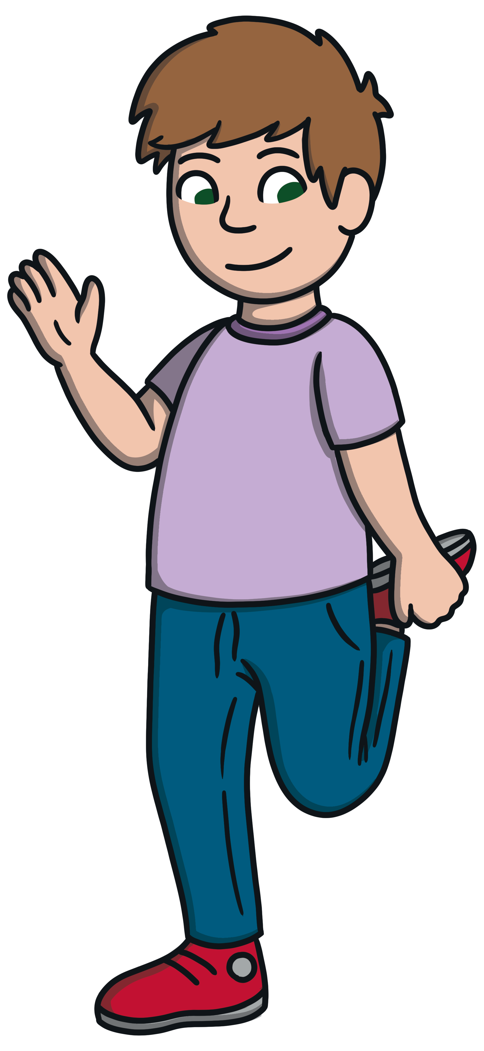
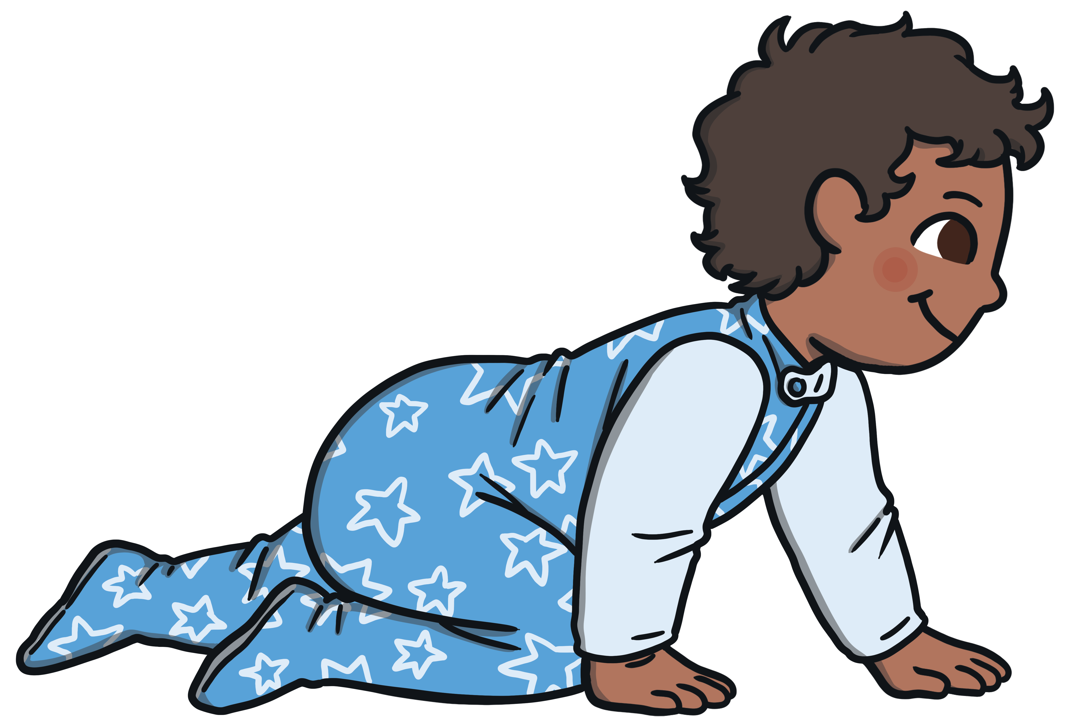
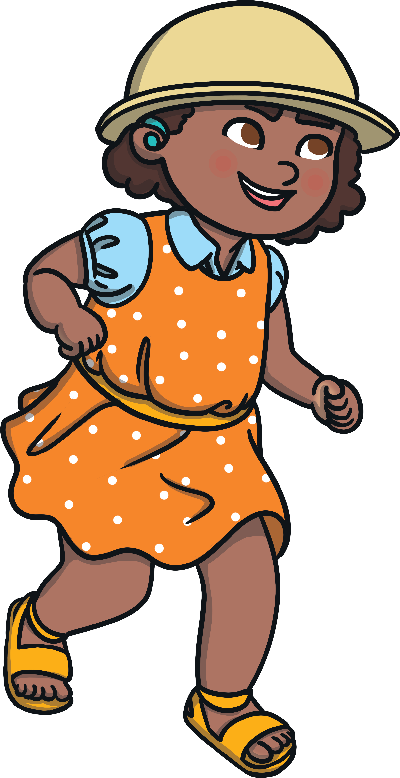
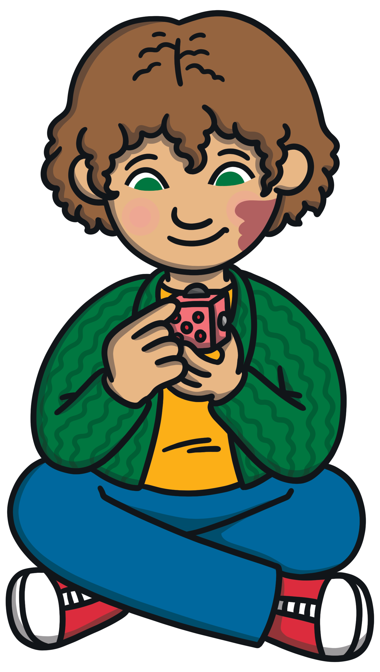
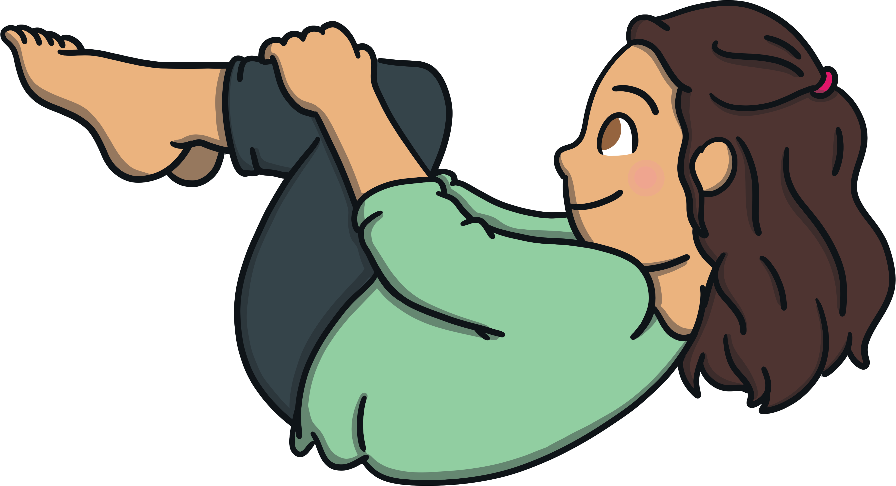
Our Bodies
Which parts of their bodies are these children using?

Slide 9
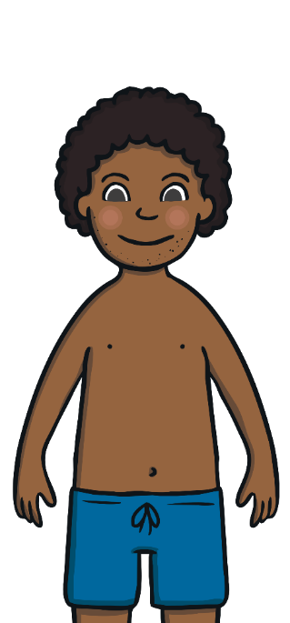
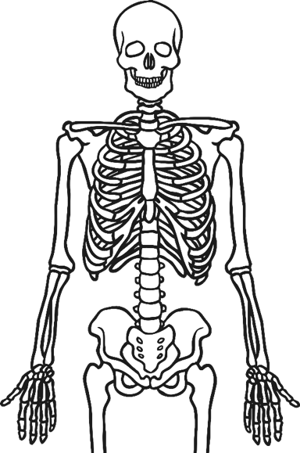
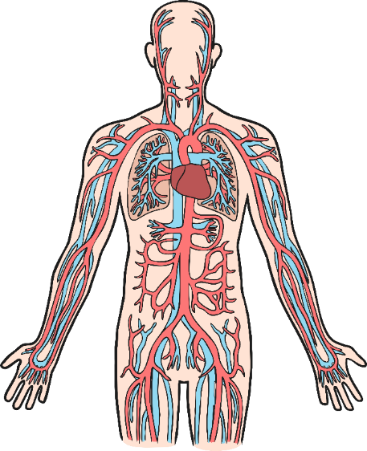
Our Bodies
Most of our body parts, inside and out, have special jobs to do.
Can you and your talk partner think of another body part and what it does?

Slide 10
Exploring

Slide 11

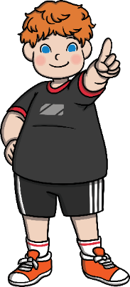
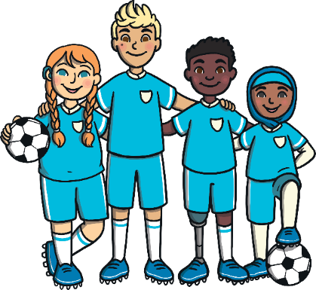


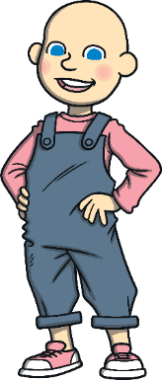
Differences and Similarities
It’s important to remember that everyone is unique and not everyone’s body looks exactly the same.
There might be things that are the same and things that are different about your body and your talk partner’s body. Can you find three similarities and three differences?

Slide 12
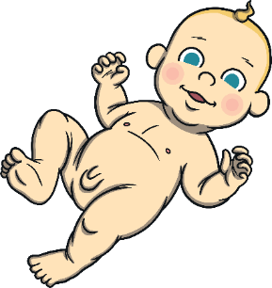
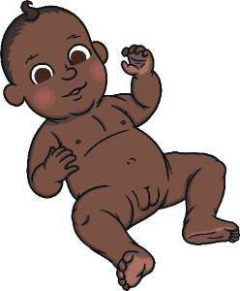
Differences and Similarities
The way we look often lets others know if we are a boy or a girl and sometimes, our names can be a clue - but not always.
What about our bodies?
Are they the same?
Girls and boys have lots of body parts that are the same.
For example, arms, back, cheeks, shoulders, wrists, lips, toes, neck, nostrils and hips.
The list is huge!
There are some body parts that are different between most boys and girls. Can you spot them on the pictures of these babies?

Slide 13
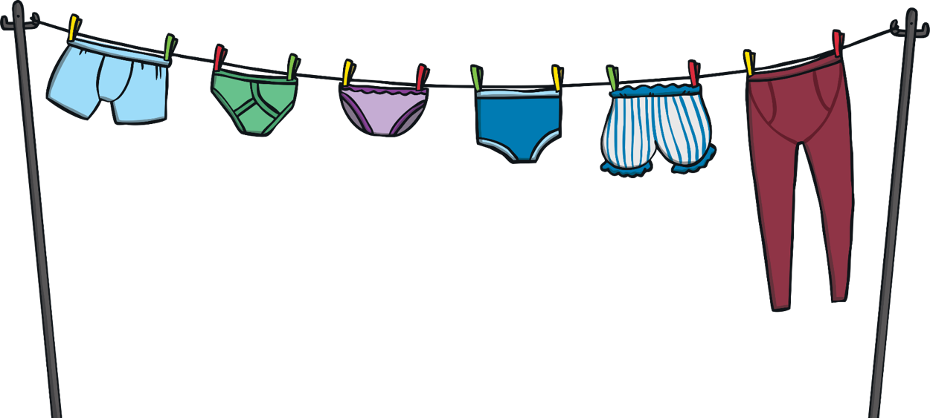
Differences and Similarities
These differences between male and female bodies are hidden under our underwear. They’re often called our private parts.
You probably have words you use for these body parts but today we’re going to use the scientific words - the words a doctor would use.
The scientific word for our private parts is genitals.

Slide 14
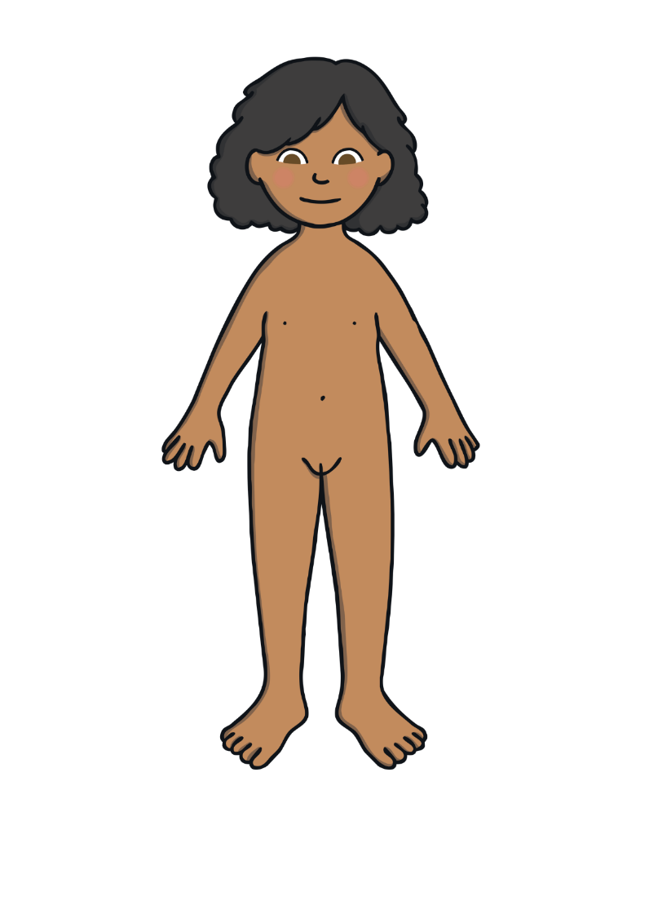
Private Parts
Girls have a body part called a vulva, which is on the outside of the body and a vagina, which is inside the body.
People have other words that they use for these parts of the body but the scientific words are vulva and vagina.
These are parts of the female body, that’s girls and women.
Female and male bodies both have nipples.

Slide 15
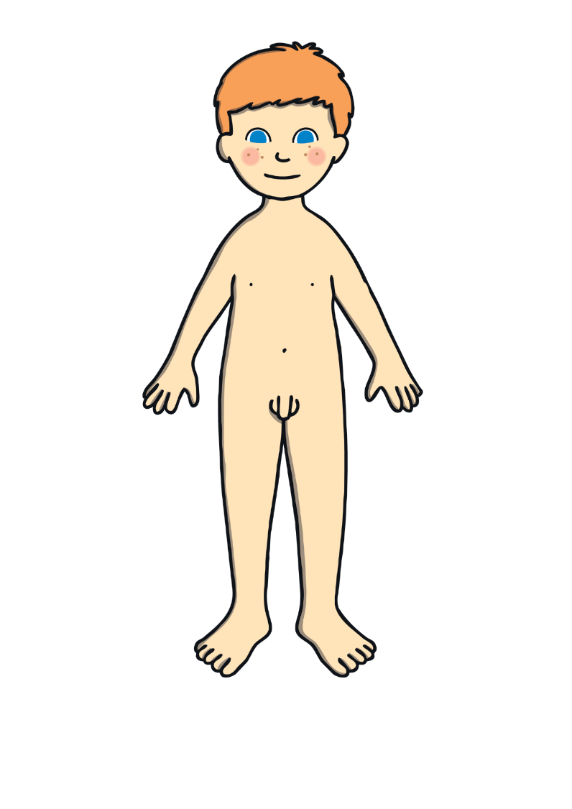
Private Parts
Boys have a body part called a penis.
People have other names they use for this part of the body but the scientific word is penis.
Behind the penis are the testicles.
These are parts of the male body, that’s boys and men.
Female and male bodies both have nipples.

Slide 16
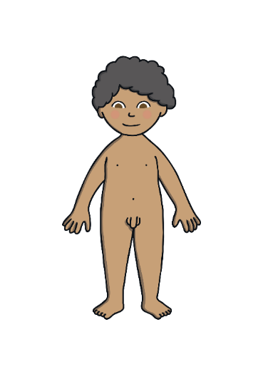
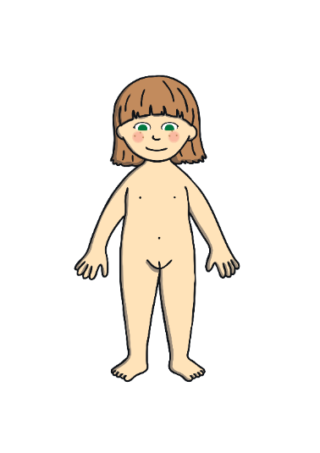
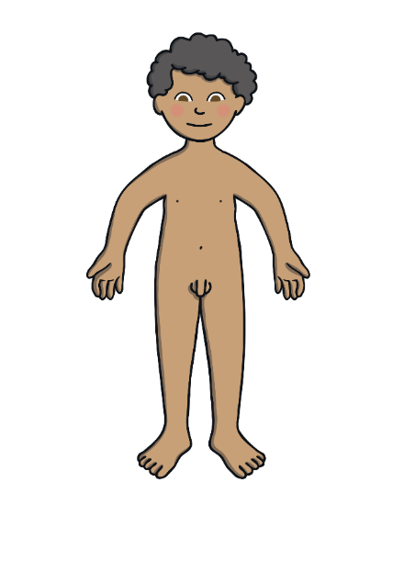
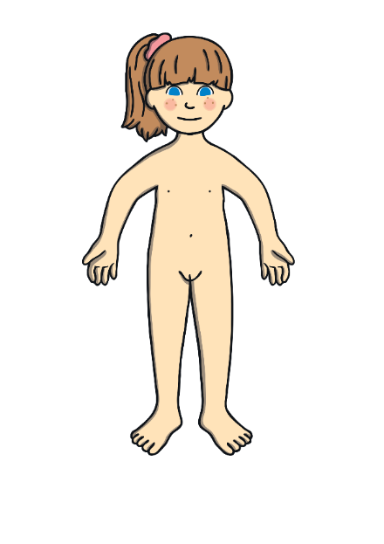


Private Parts
When we were babies, we didn’t think about doing things in private or hiding our private parts.
Babies and toddlers don’t mind people seeing them in the bath and are sometimes naked at the beach, but they don’t feel embarrassed.
As we get older, we might find that we like more privacy. We like to wear a swimming costume or swimming shorts at the pool or the beach. We like to go to the toilet in private and we might not want to take a bath with our brother or sister anymore.

Slide 17
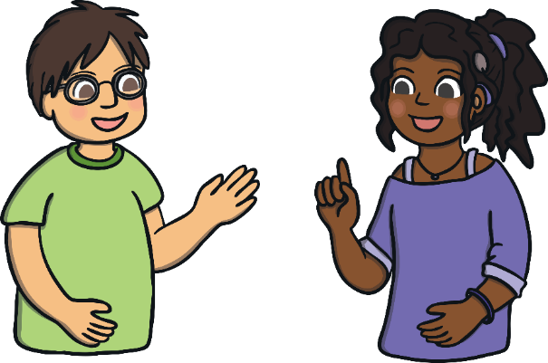

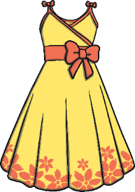
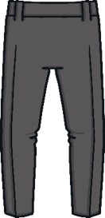

Consolidating
Reflecting

Slide 18
Consolidating

Slide 19

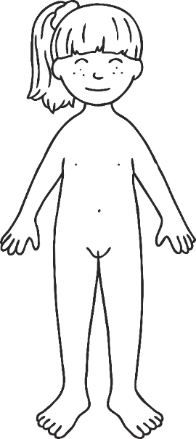
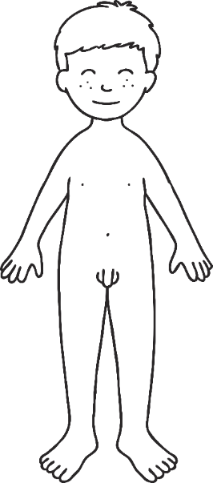

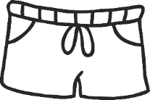
At the Pool
On your activity sheet, there is a boy and a girl who want to get ready to go swimming. Label the body parts by writing the correct words in the boxes. Then, design their swimming costumes so they are ready for a swim at the pool.

Slide 20
Reflecting

Slide 21
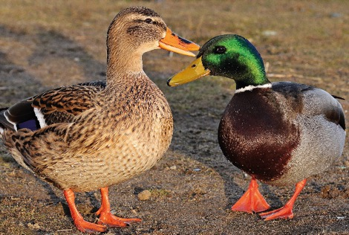
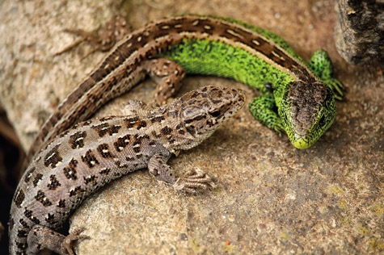
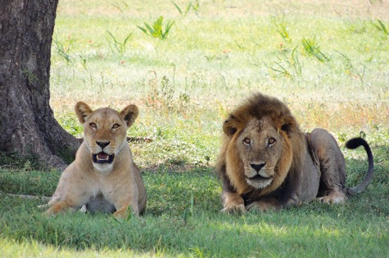
Males and Females
It isn’t just humans who have different male and female bodies. Look at these animals and spot the differences. Do you think there might also be differences we can’t see in the pictures?

Slide 22
The Big Questions

Slide 23
The Big Questions
What are the main parts of our bodies?
Which body parts are private?

Slide 24
LI
I can name the main parts of the body.
Success Criteria
I can use the scientific names for parts of the body.
I can name similarities and differences between different people’s bodies.
I can identify private body parts.

Slide 25


