Slide 1

PSHE and Citizenship
Health and Wellbeing | Growing Up
PSHE and Citizenship | LKS2 | Health and Wellbeing | Growing Up | Relationships and Families | Lesson 5

Slide 2
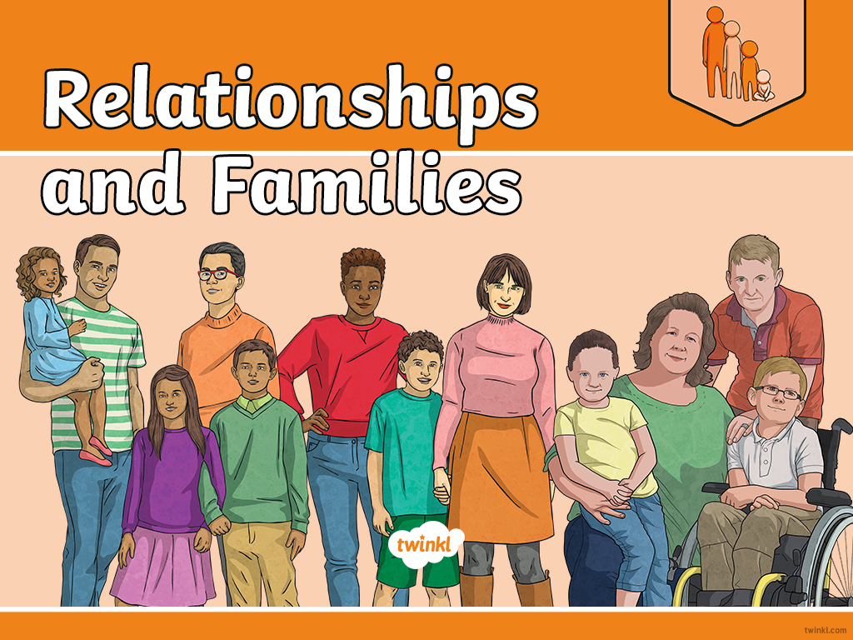

Slide 3
LI
I understand that there are many different types of relationships and families.
Success Criteria
I can identify and describe different relationships, different families and different family members.
I can understand and use terms such as gay, lesbian, single-parent, fostered, adopted, married and civil partnership.
I can identify elements of a healthy, loving relationship.
This resource is fully in line with the Learning Outcomes and Core Themes outlined in the PSHE Association’s Programme of Study.

Slide 4
The Big Questions

Slide 5

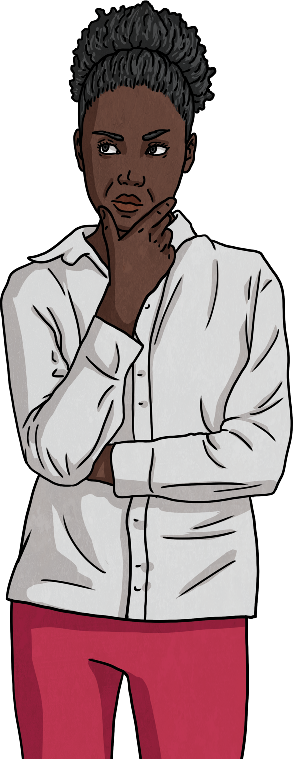
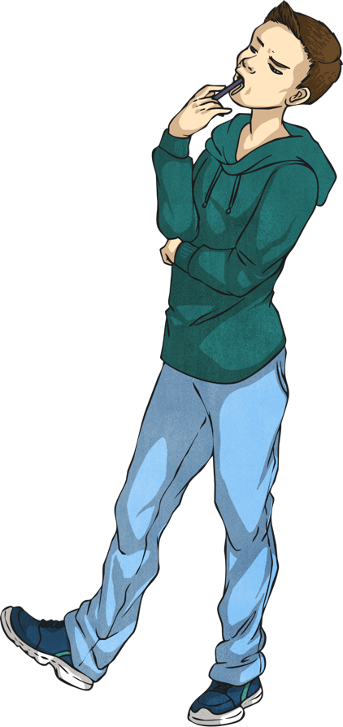
What are loving relationships like?
What kinds of family are there?

Slide 6
Reconnecting

Slide 7
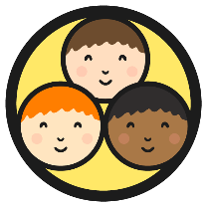
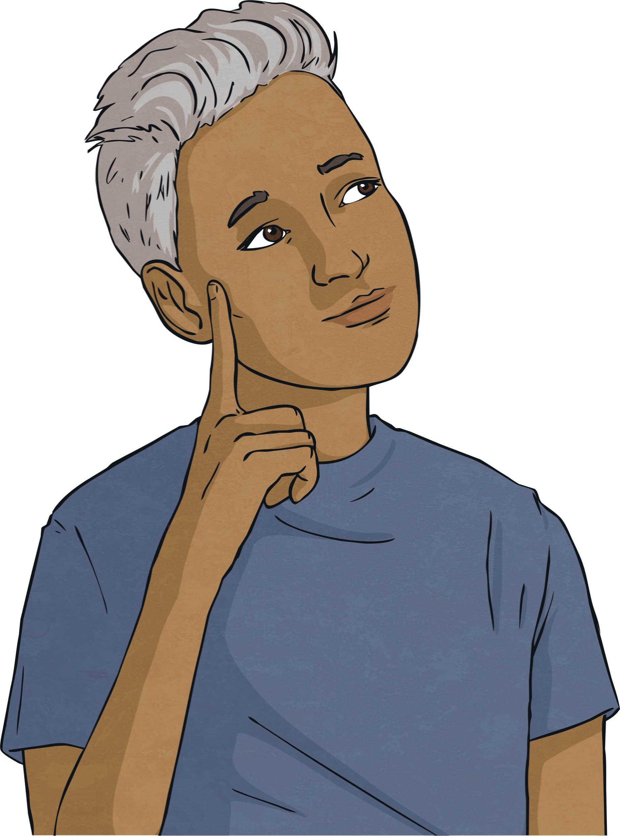
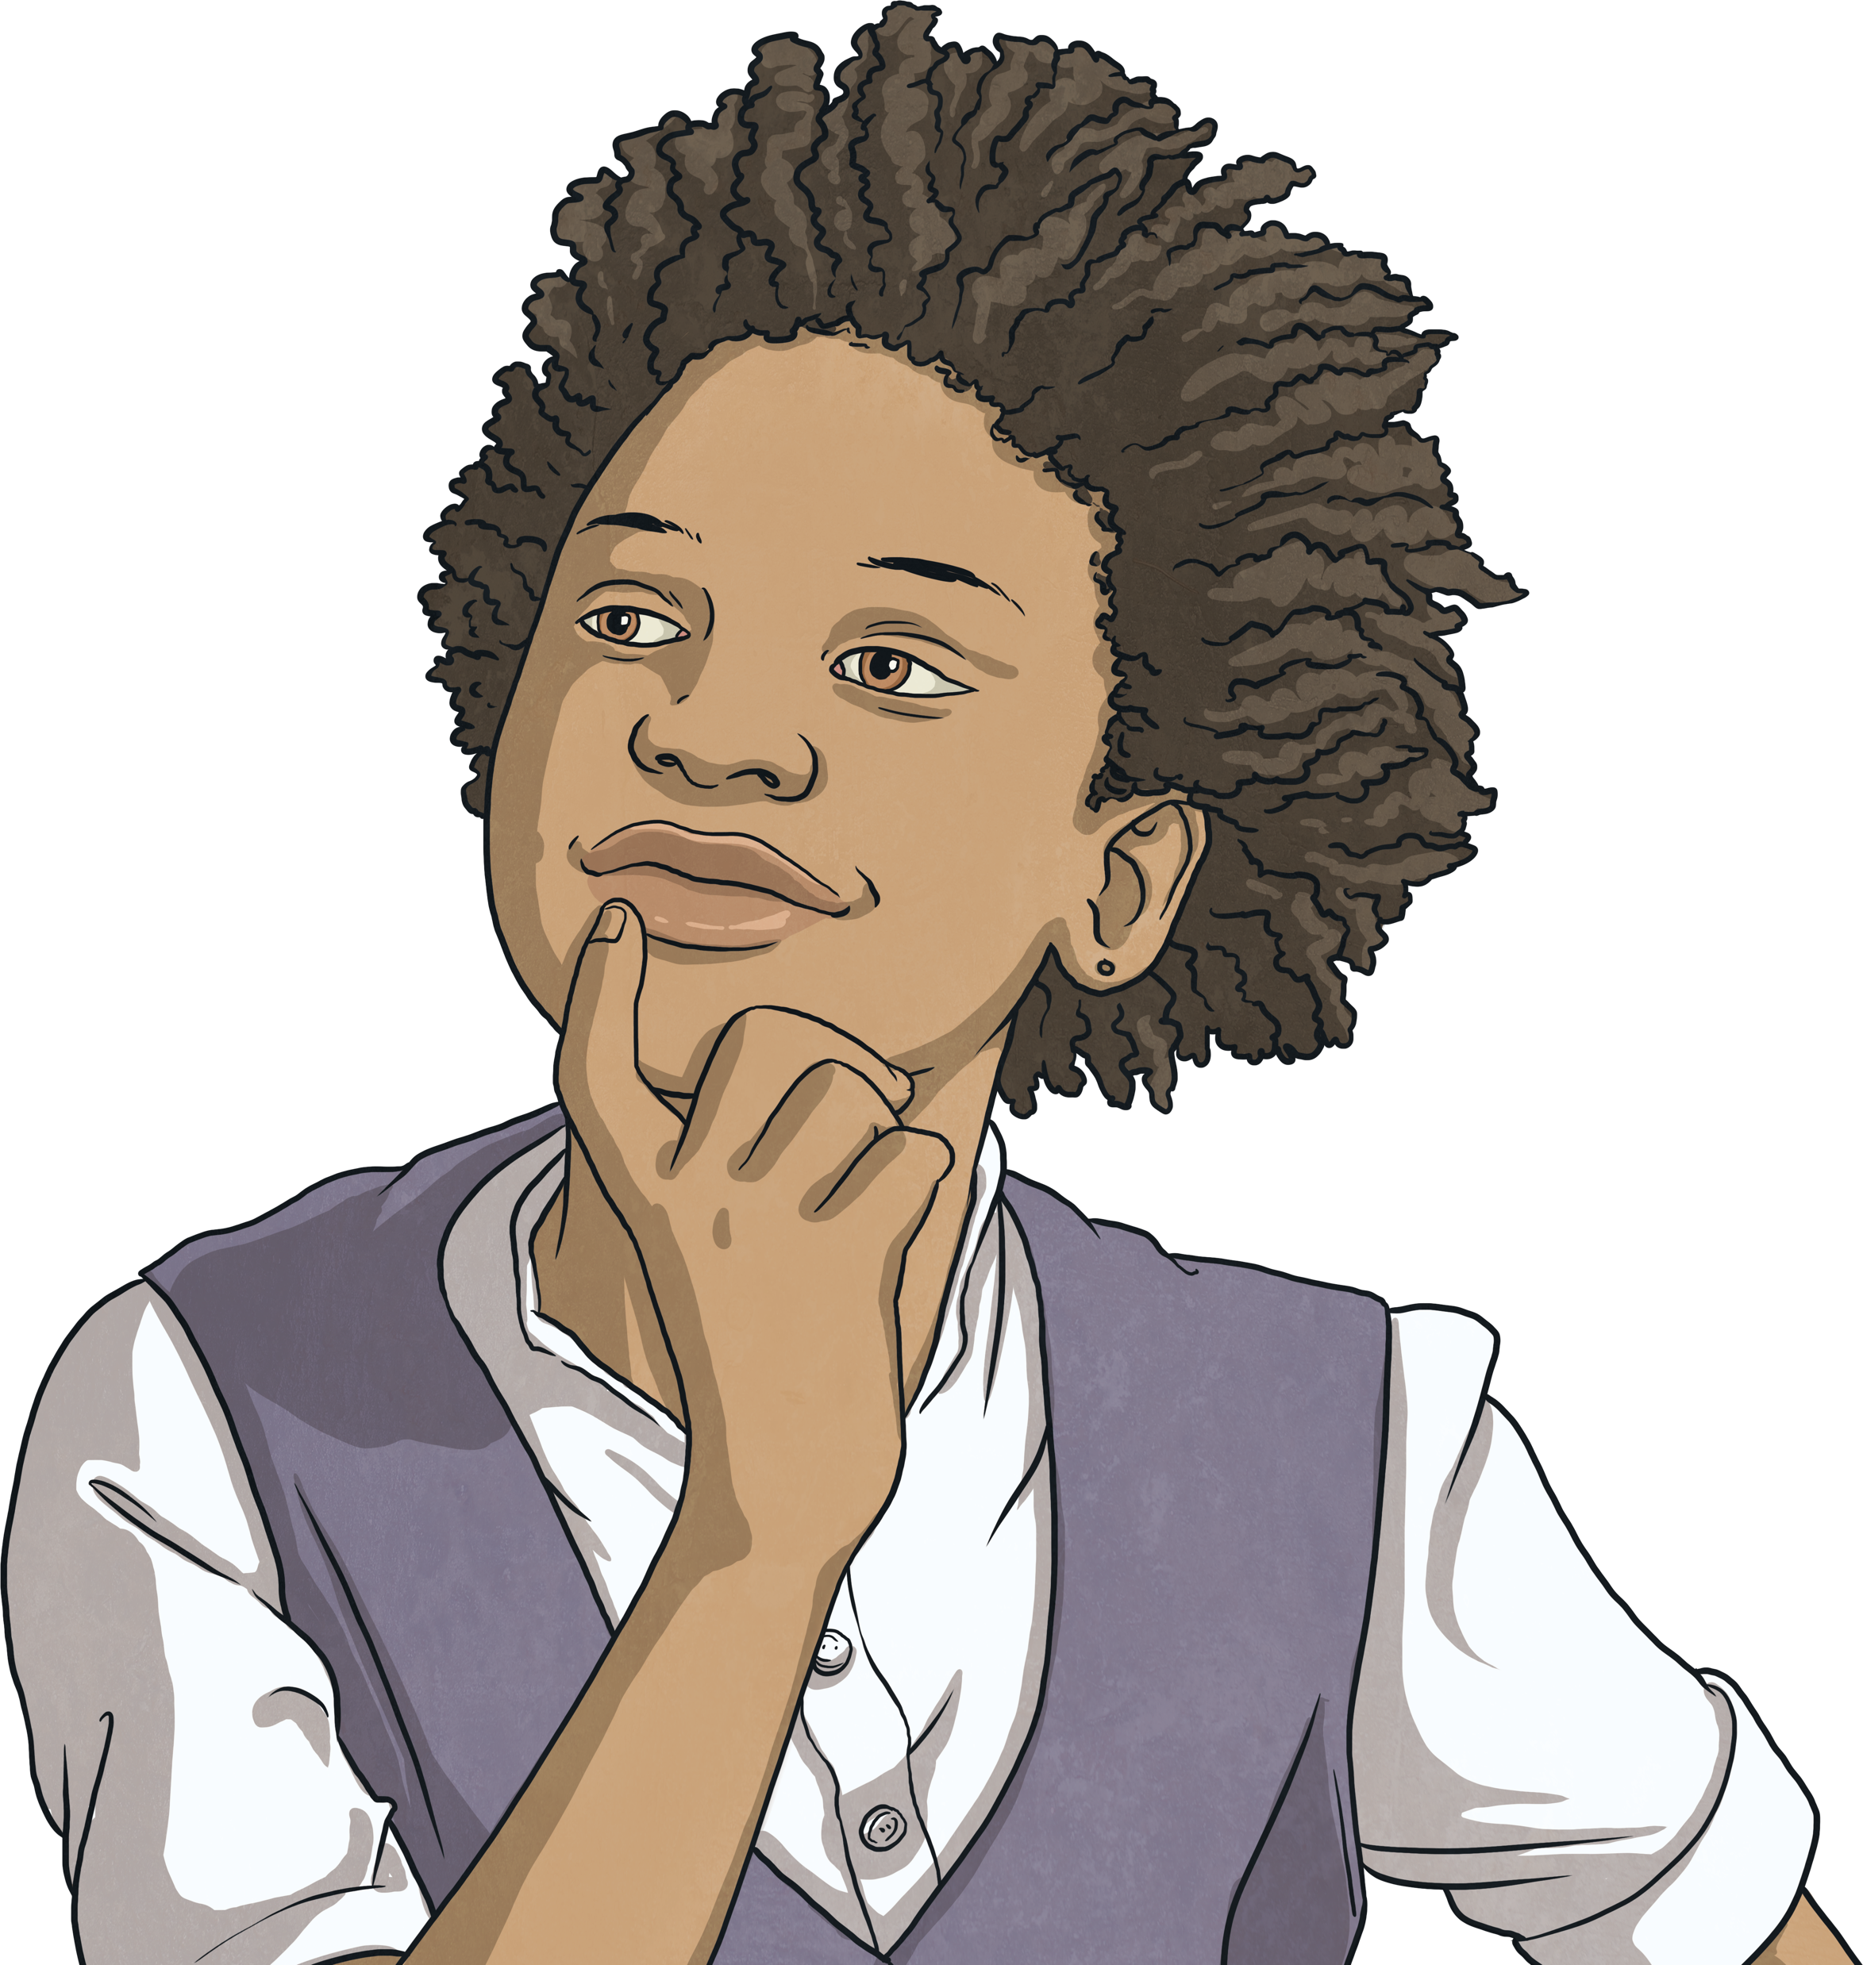
Different Relationships
Think about the relationships in your family.
What relationships do you have at school?
Are there different ways to love someone?
As we go through life, we have many different types of relationships with many different people:
We have different relationships with different family members.
We have different relationships with different friends.
Some people, when they get older, have romantic relationships with others and might choose to be part of a couple.

Slide 8
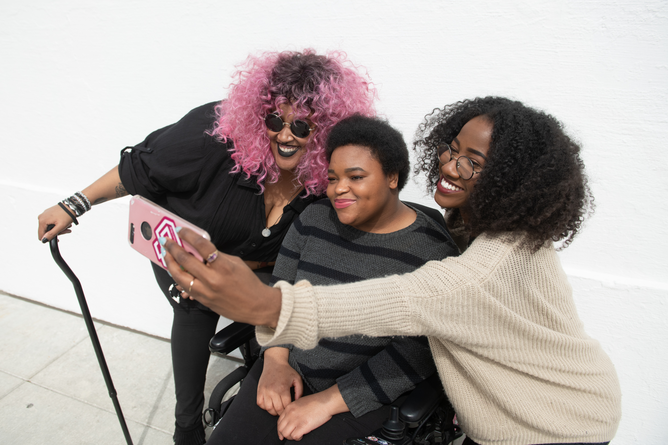
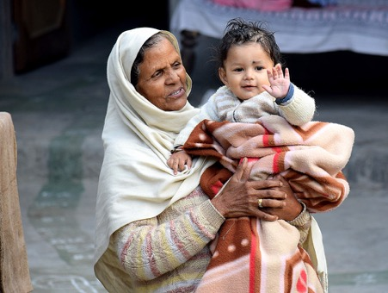
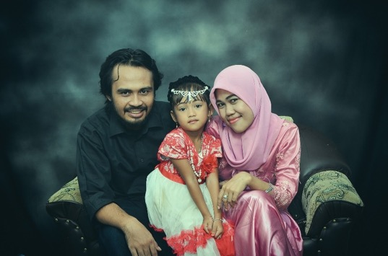
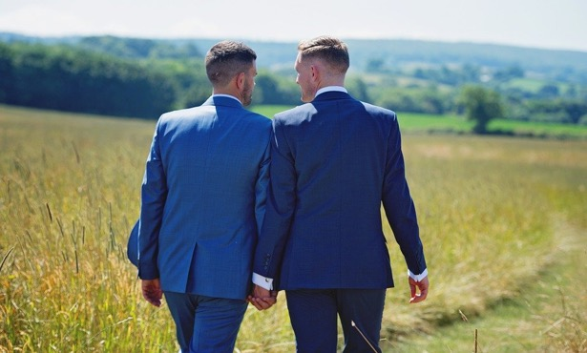
Different Relationships
What relationships can you see here?
“disabledandhere-008” by [Disabled and Here] is licensed under CC BY 4.0

Slide 9
Exploring

Slide 10

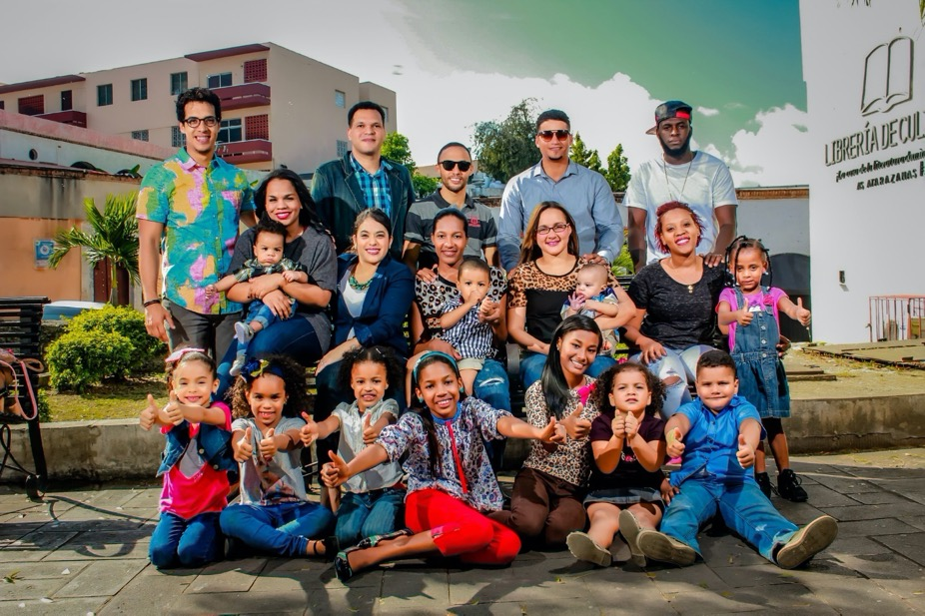
Relationships Within Families
How might all these people be related? Think of all the family member names you know to describe the relationships between people.

Slide 11
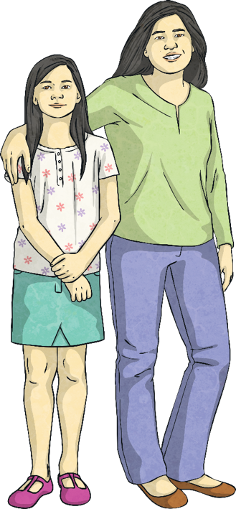
Relationships Within Families
Families can contain parents, children, grandparents, brothers, sisters, aunts, uncles and cousins.
Some families contain half-brothers or half-sisters.
Some families contain step-dads, step-mums, step-brothers or step-sisters.
Some families have no parents. Some families have mums, some families have dads and some families have both. Two mums (a lesbian couple) or two dads (a gay couple) are called same-sex parents.
When there is just one parent in a family, they are called single-parent families.

Slide 12
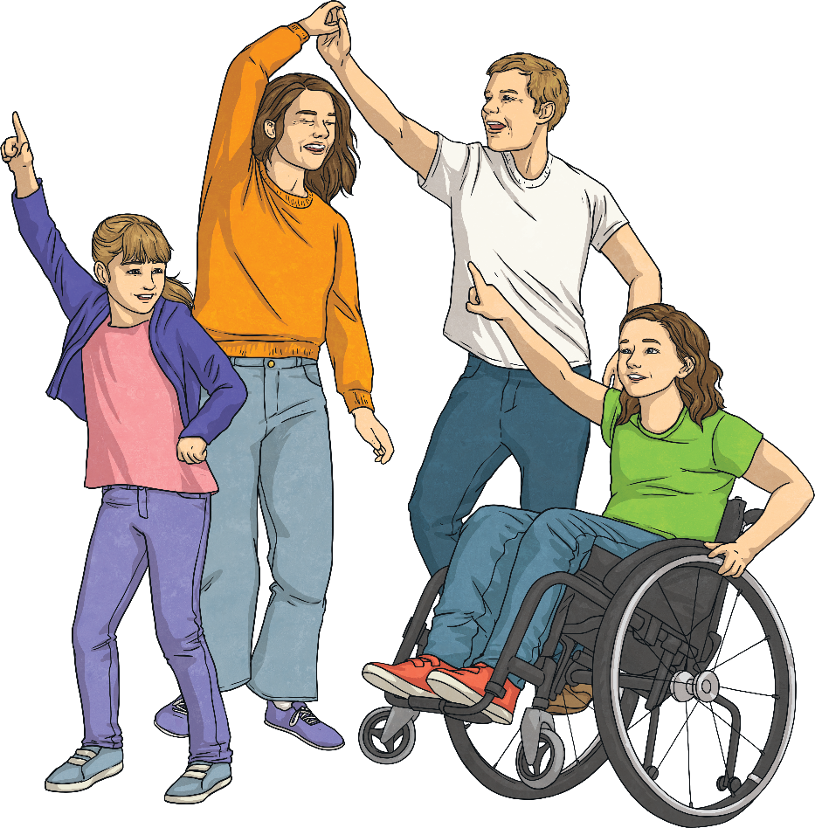
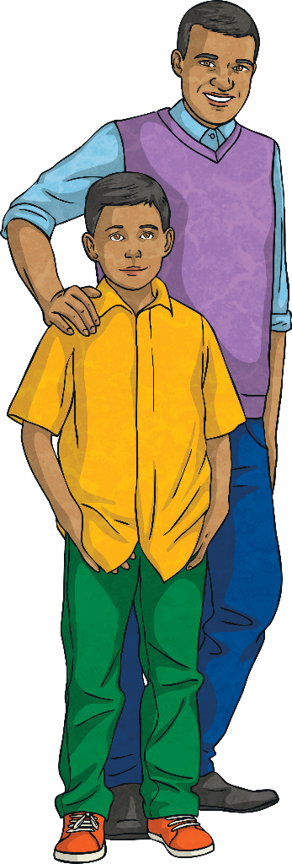
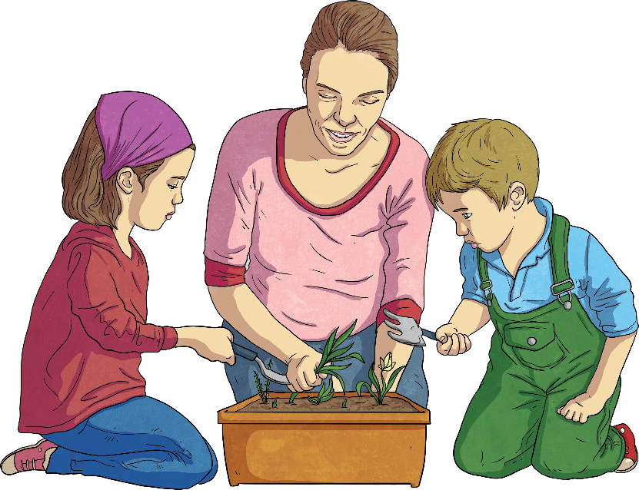
Relationships Within Families
Some children don’t live with their parents. In some families, children might be looked after by grandparents, aunties or uncles.
In other families, children live with carers - people who look after them who are not related to them but who care for them in all the same ways that a parent would care for a child.

Slide 13
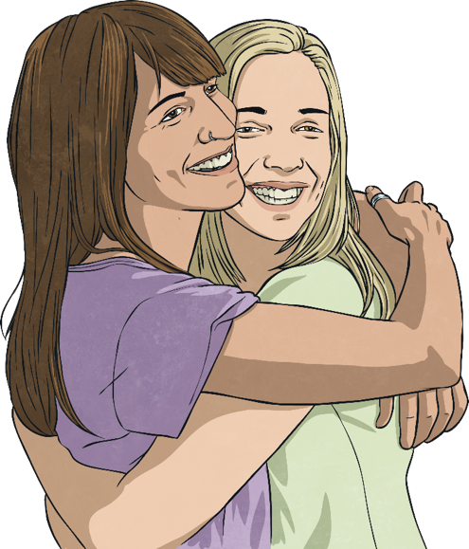
Relationships Within Families
In some families with two parents, the parents are married.
In others, the couple might be in a relationship called a civil partnership.
When two people want to be together and stay together, they make a commitment to each other. They promise to love and care for one another and often they celebrate this promise with their family and friends.
Two people who love and care for one another can be in a committed relationship, without being married or in a civil partnership.

Slide 14
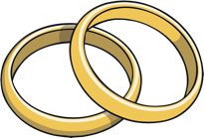
Relationships Within Families
Marriage is an agreement entered into by two people who love each other. Both people must be happy to get married.
Forcing someone to marry when they don’t want to is a crime.

Slide 15
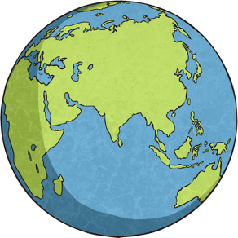
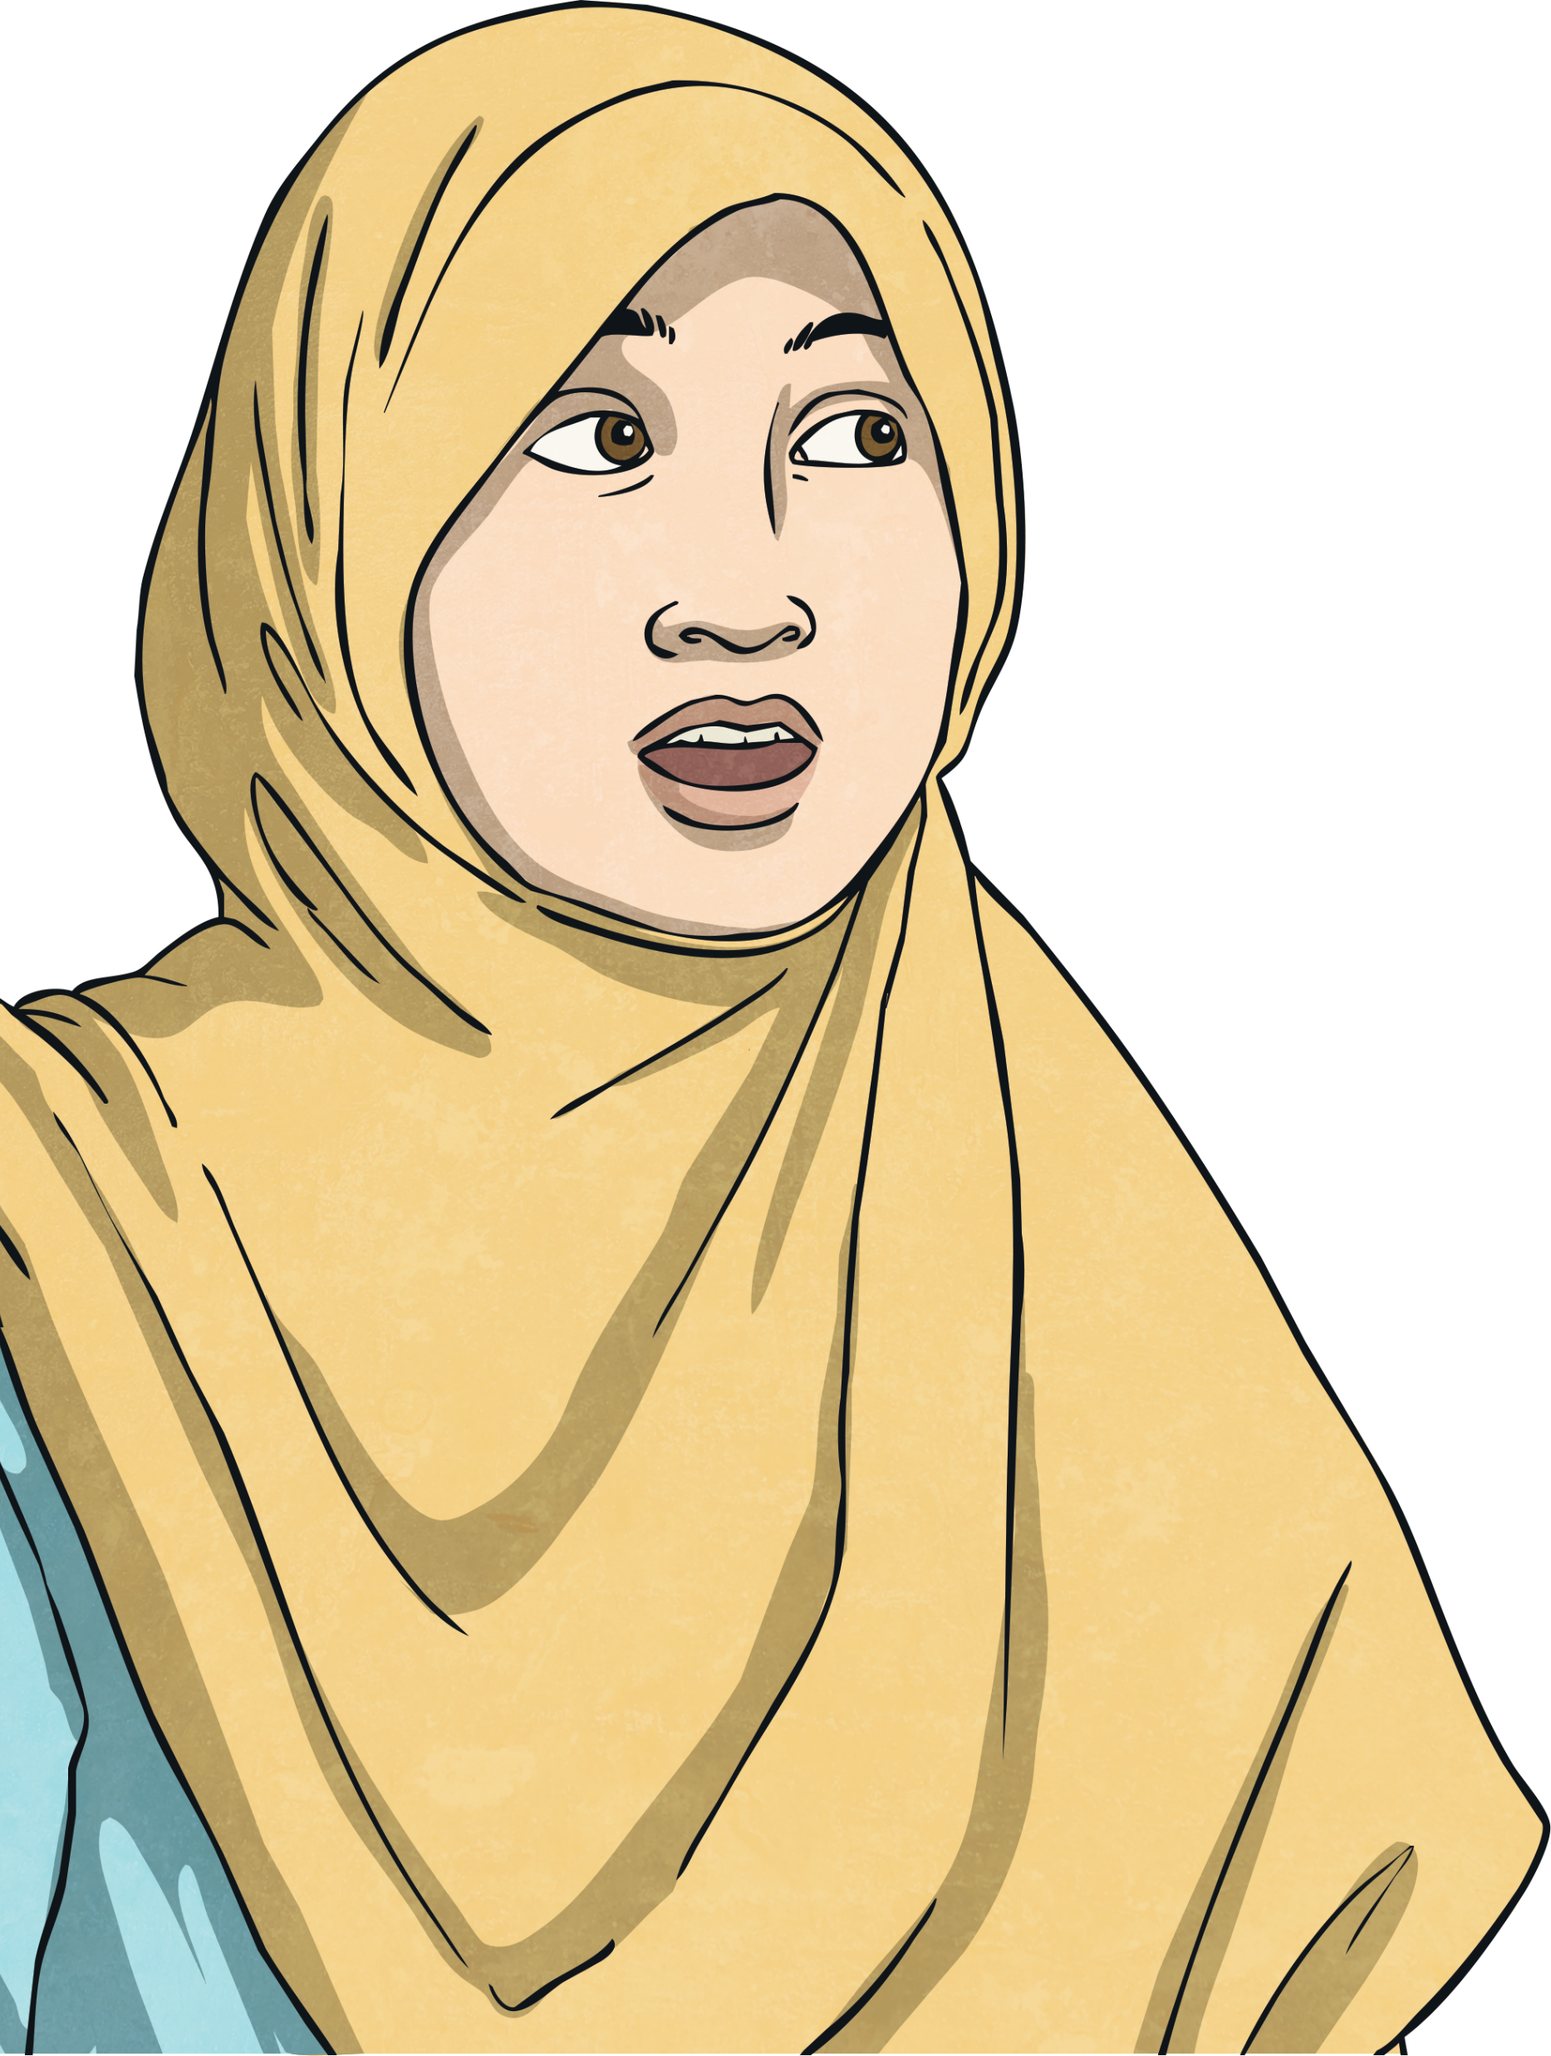
Diverse Families
Diversity means difference and it’s a great thing to celebrate. The world would be a very boring place if we were all the same!
Learning about other people, different types of relationships and other families that might be different from our own is important.
Remember – there is no ‘normal’ type of family or ‘normal’ way to be and it is important to respect the differences between us all.
Let’s meet some families and some individuals. They may be like your family or someone you know or they may be different.

Slide 16
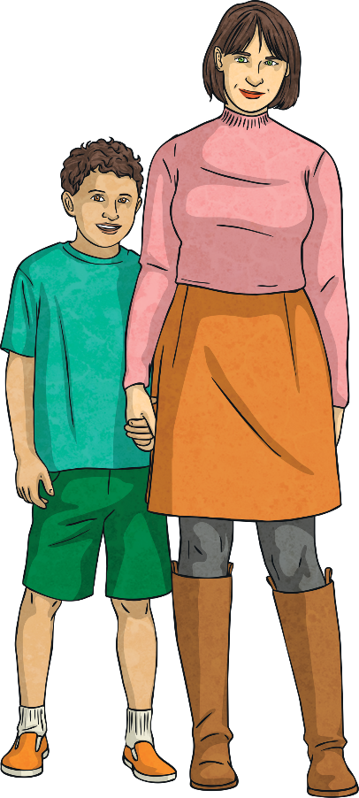
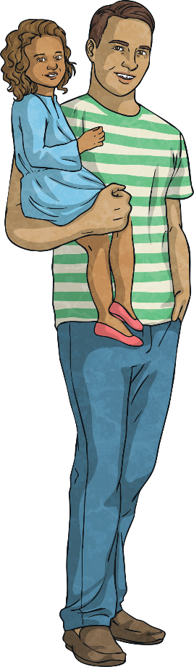
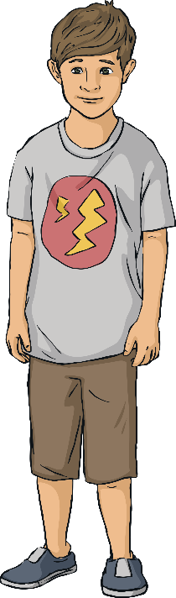
Diverse Families
This is the Ayoade-Davies family. They are a blended family.
David and Lena had both been married previously and had each had a child with the partner they were once married to.
They then split up from their partners and got divorced. Some time later, David and Lena met at the gym they both go to and began a relationship.
Four years later, they live together with David’s son, Lena’s son and the baby daughter they have had together. They have chosen not to get married.

Slide 17
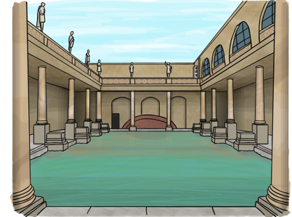
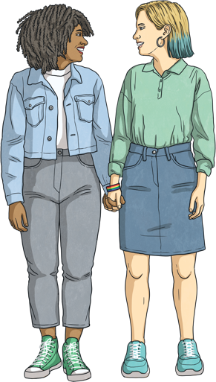
Diverse Families
This is Freya. She’s 19 and goes to university in a city called Bath, where she is studying physics.
Freya is bisexual which means she is attracted to men and women.
Freya had a boyfriend when she was at
school, before she came to university, but they broke up.
She now has a girlfriend who she met in one of her physics classes.

Slide 18
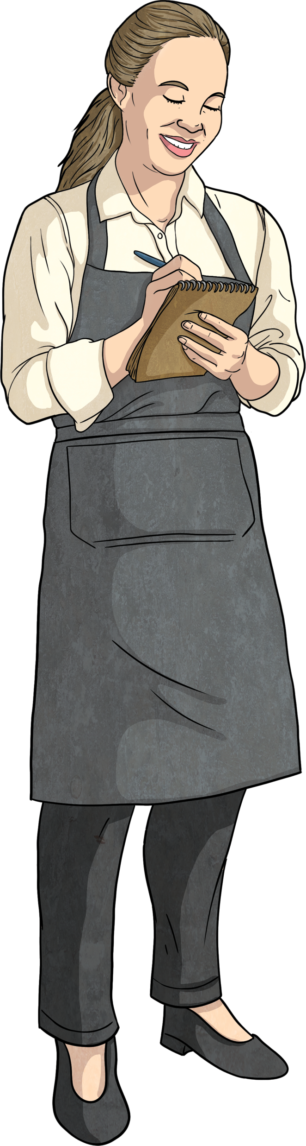
Diverse Families
This is Bella. She moved to England with her father when she was nine years old.
Sadly, when Bella was 14, her father died so her grandmother came to England to look after her.
Now, Bella is 18. She still lives with her grandmother and she also now has a son. They share a small flat.
Bella’s grandmother doesn’t speak much English, so she looks after Bella’s son while Bella works at a café to earn some money to support them all.

Slide 19
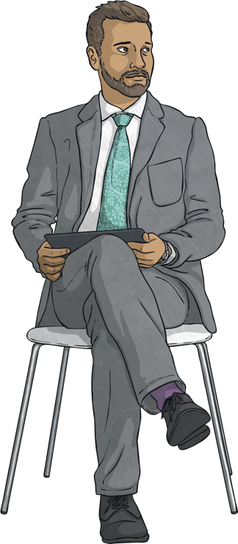
Diverse Families
This is Max. He is a tutor at a university. Max is 31 years old and lives on his own.
Max is asexual, which means he isn’t attracted to men or women. He has many close friends who are very special to him but he isn’t looking for a partner to be in a relationship with.
When Max was growing up, he was confused as everyone around him seemed to be talking about who they liked and almost all the adults he knew were in relationships.

Slide 20
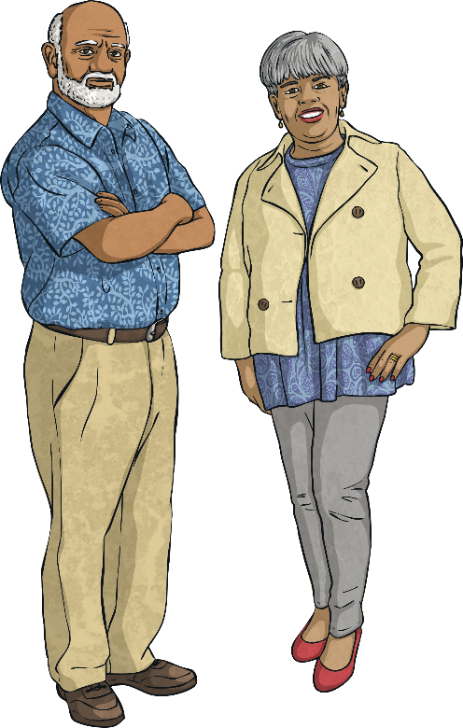
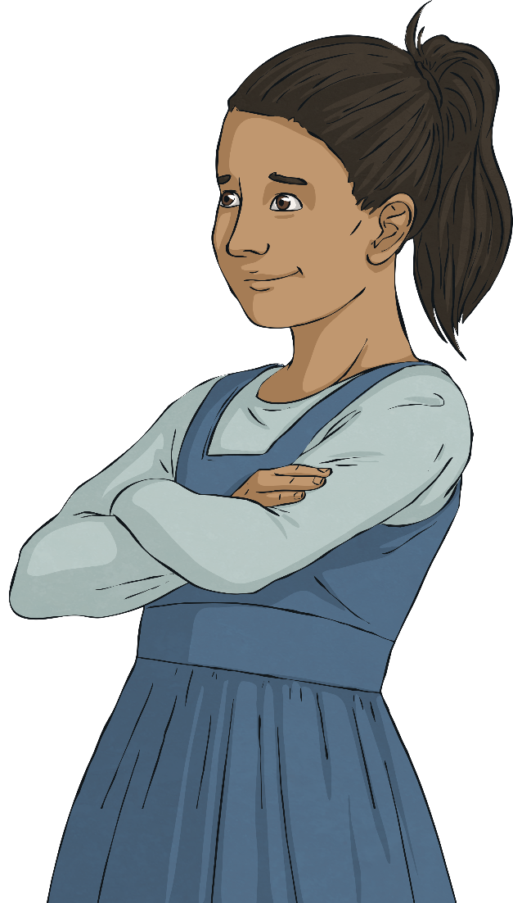
Diverse Families
This little girl is called Laila. She lives with her grandparents because her mother is poorly.
Laila’s grandparents are her main carers which means they take her to school, read her bedtime stories at night and take her to the park at the weekend.
Grandma is busy organising Laila’s birthday party at the moment, which is next month.

Slide 21
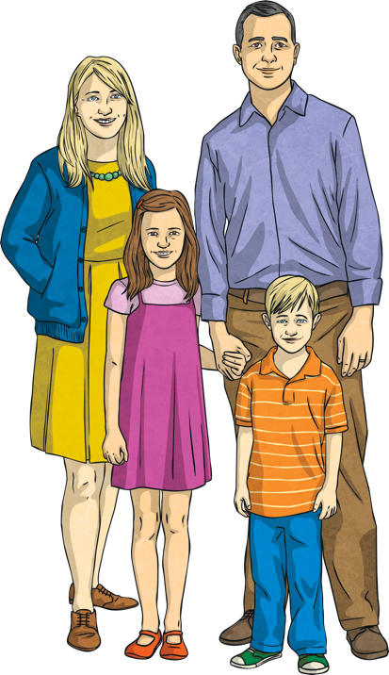
Diverse Families
Meet Katrina and Jacob. They are a married couple who are also foster parents. They have been looking after children whose parents are unable to care for them for many years now.
Sometimes, Katrina and Jacob have just one foster child living with them but at times, there might be as many as four.
At the moment, they are looking after two children – a brother and sister.

Slide 22
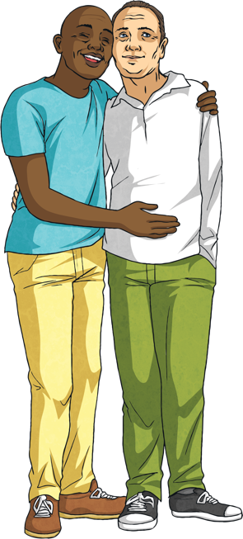
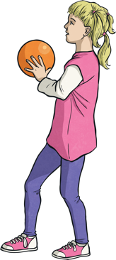
Diverse Families
This little girl is called Abigail. She was adopted as a baby by her parents, Pete and Mikey.
Abigail (or Abi for short) is growing up in a loving, secure family who can provide for her. This might not have been possible if she hadn’t been adopted.
Pete and Mikey are in a civil partnership, which is a type of committed relationship.
Abi’s favourite things to do with her dads include watching films about princesses and mermaids and going swimming.

Slide 23
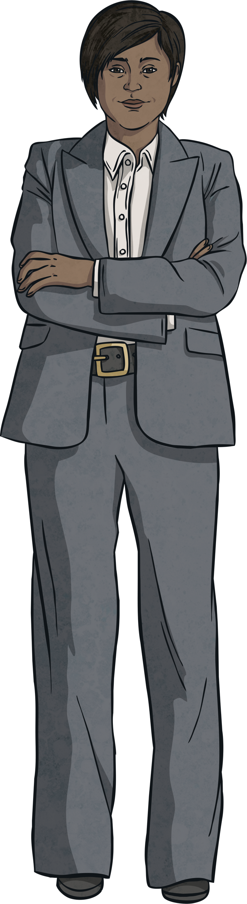
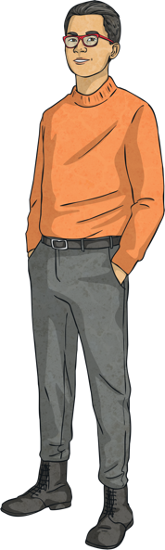
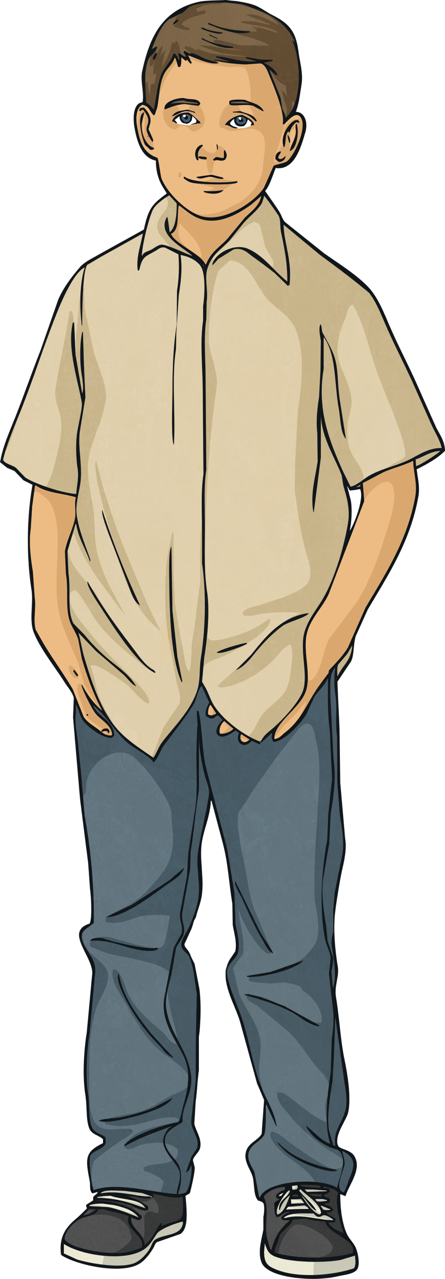
Diverse Families
Meet the Pye family. There’s Mum, Dad and their son, Jay.
Jay’s parents are married and are committed to one another but they live apart.
Jay’s mother works for a famous charity and lives abroad most of the time.
Jay lives in Scotland with his dad and they visit his mum when they can, or she comes back to Scotland to visit them.

Slide 24

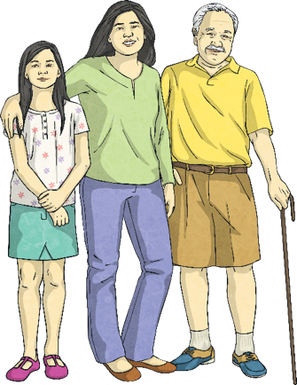
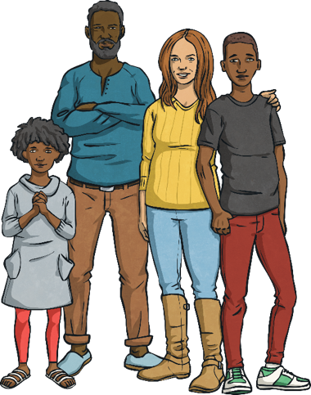
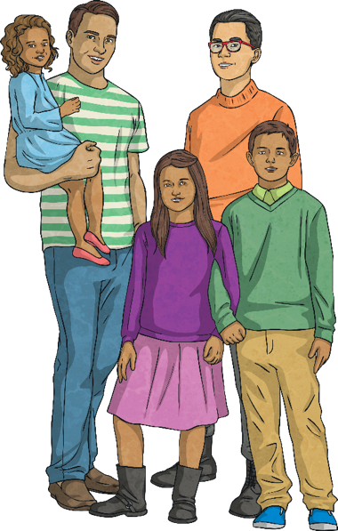
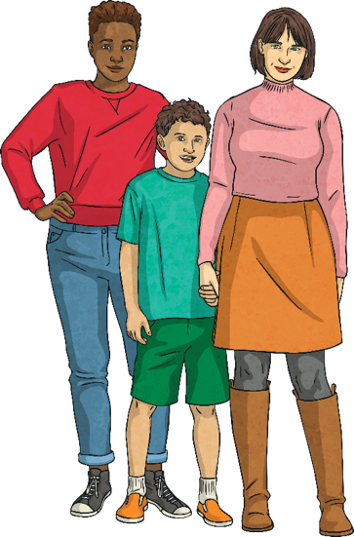

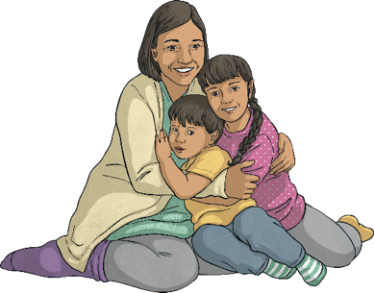
Different Families
Describe the different families you can see here with your partner.

Slide 25
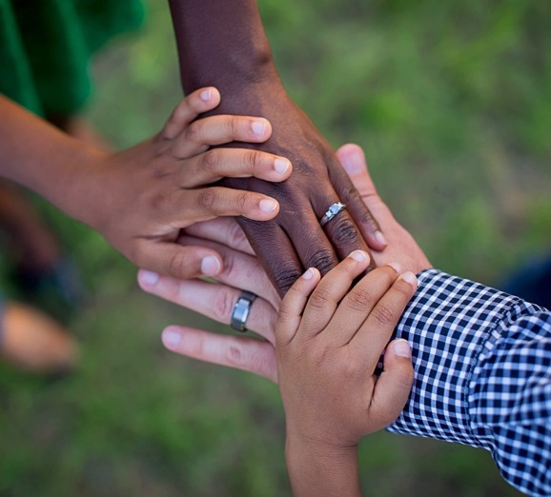
Different Families
All families are different.
Families can be very small or very large.
There can be people of different ages and people from different races.
Families can live together or apart.
There is no right or wrong when it comes to families.
But what do all families have in common?
Consolidating
Reflecting

Slide 26
Consolidating

Slide 27


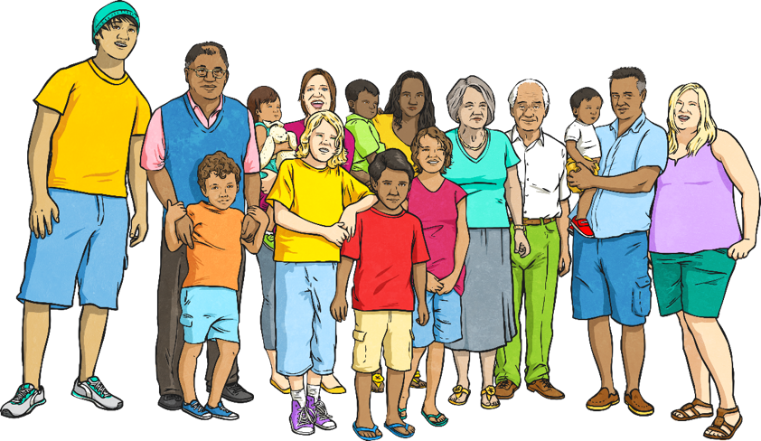
Relationships and Families
Most of us think that all families are like our own family, as that’s all we really know. Your job today is to design a poster to show people that there are lots of different families but that they all have one thing in common – love!

Slide 28
Reflecting

Slide 29
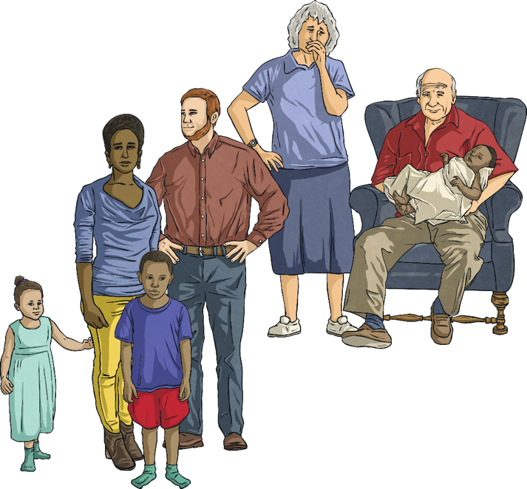
Caring and Loving
With your talk partner, list as many things as you can that lots of families have in common.
Can you think of examples of these things in your own family?
Do different people in the family have different roles?
How do the people in your family show they care for one another?

Slide 30
The Big Questions

Slide 31
What are loving relationships like?
What kinds of family are there?

Slide 32
LI
I understand that there are many different types of relationships and families.
Success Criteria
I can identify and describe different relationships, different families and different family members.
I can understand and use terms such as gay, lesbian, single parent, fostered, adopted, married and civil partnership.
I can identify elements of a healthy, loving relationship.
This resource is fully in line with the Learning Outcomes and Core Themes outlined in the PSHE Association’s Programme of Study.

Slide 33



