Slide 1
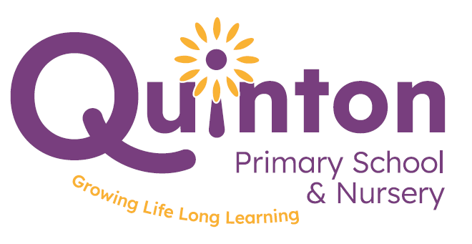
Meet the Teacher Evening
2025
https://vimeo.com/1092808346/34626906b5

Slide 2
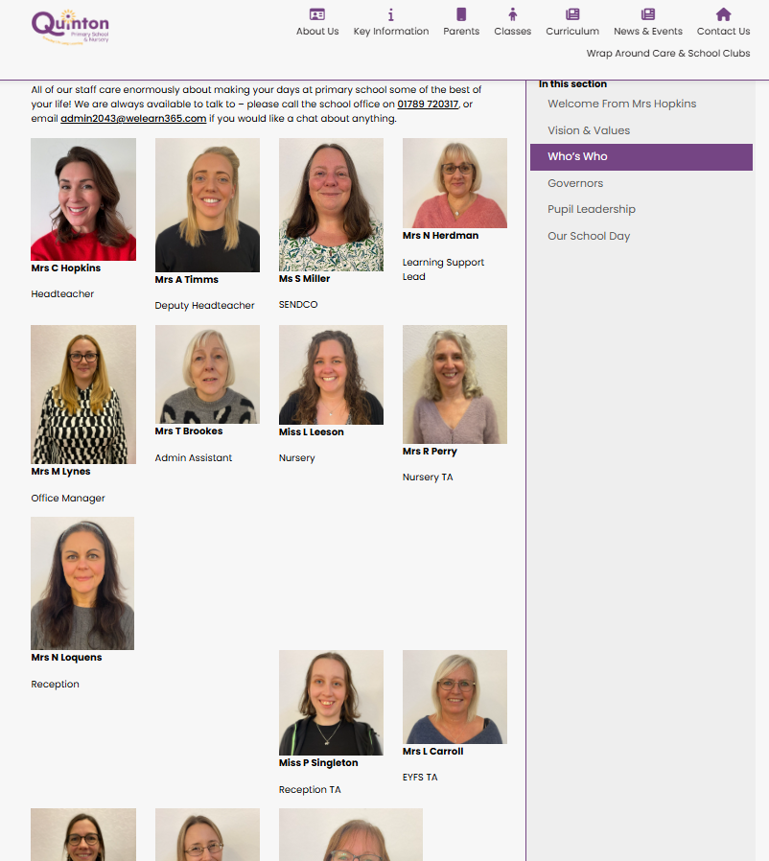
Who’s Who?
Leadership Team
Charlotte Hopkins (Headteacher)
Amy Timms (Deputy Head)
Naomi Loquens (EYFS Lead)
Grace Gibson (Maths)
Becks Don-Duncan (English)
Office Staff
Michelle Lynes (M, T, W)
Nicki Herdman (Th, F)
Tina Brookes
Designated Safeguarding Leads
Charlotte Hopkins
Amy Timms
Sarah Miller (SENCo)
Nicki Herdman (Inclusion and attendance lead)
Governors
Trevor Davies (Chair)
Sue Thompsett (Vice Chair)

Slide 3
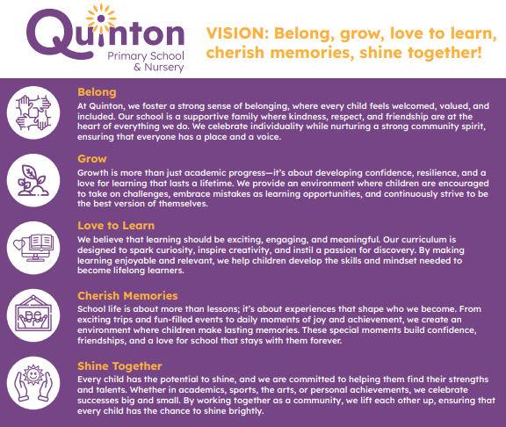
Who’s Who?

Slide 4
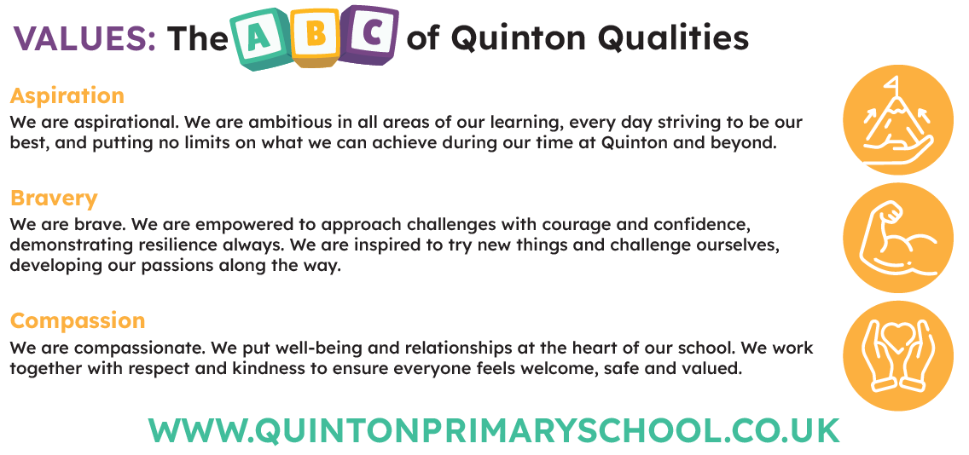
Vision & Values

Slide 5

Key Value: ASPIRATION
Celebrating strengths & igniting passions
Implementation:
Reworking existing curriculum: termly topics with a curriculum overview that clearly maps out the progression from N to Y6 (and beyond).
Focus on careers – following on from the success of the Science week sessions.
Rethinking teaching of wider curriculum subjects – subject leads to teach their subject across the school. Continuing on from the success of the art teaching a few years back.

Slide 6


Quinton’s Behaviour Curriculum
Based upon our behaviour policy
Trauma-informed approach
Relationships at the heart of everything we do
Three simple, clear and coherent rules: be ready, be respectful, be safe
Children are taught what it looks like to be ready, respectful and safe
Practise and remind
“When little people are overwhelmed by big emotions, it is our job to share our calm, not join their chaos.”
“When a flower doesn't bloom, you fix the environment in which it grows, not the flower.”

Slide 7
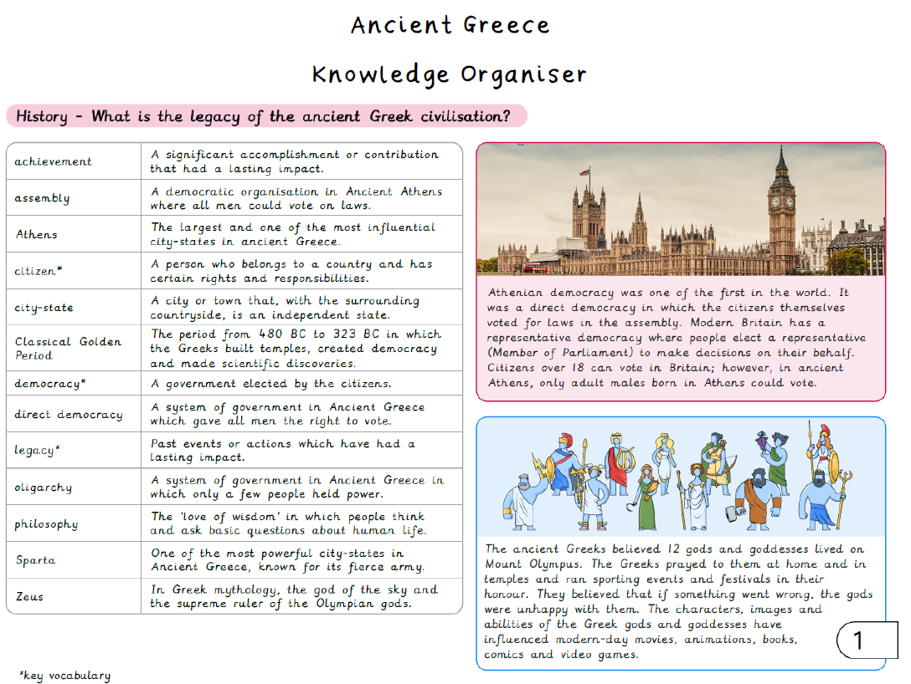
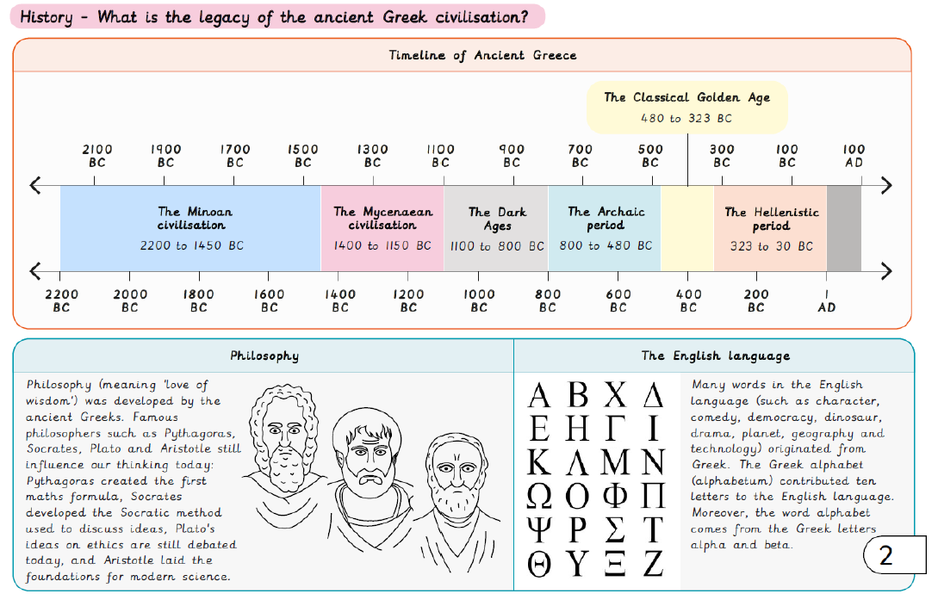
Quinton’s Curriculum
Knowledge-led
Cross curricular: history as the key driver
Discrete subjects: RE, Science, Music – but links where they lend themselves
WOW moments
Clear progression of knowledge and skills across the school – avoids repetition and ensures a deeper understanding
Retrieval quizzes/FB4 etc. in order to ensure knowledge has ‘stuck’
Taught by subject leads

Slide 8
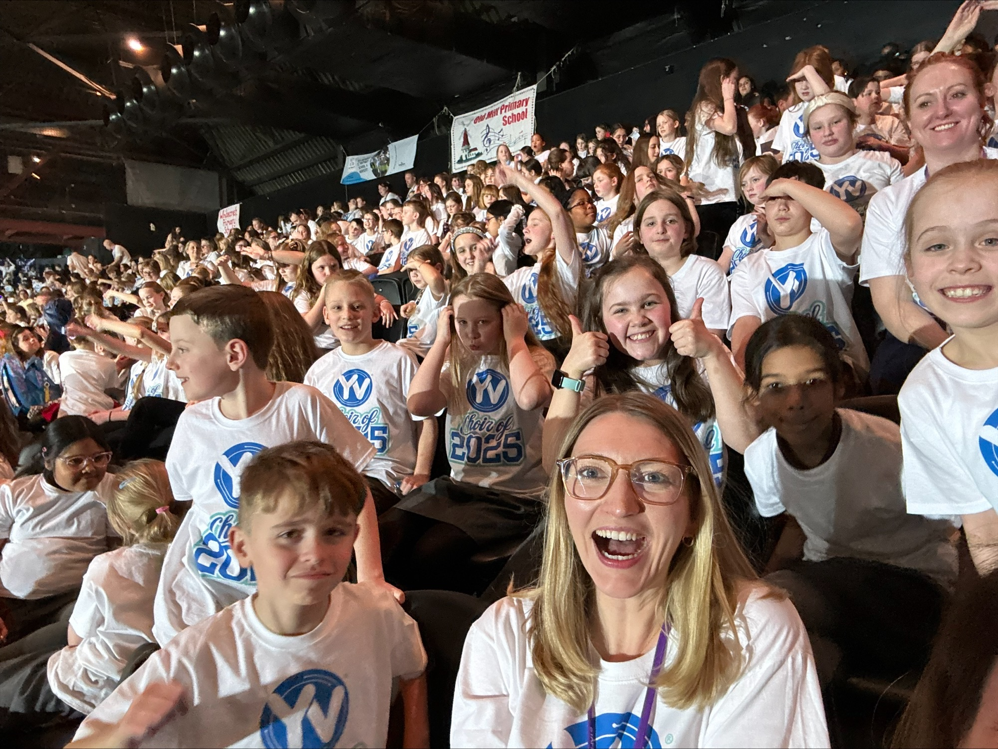
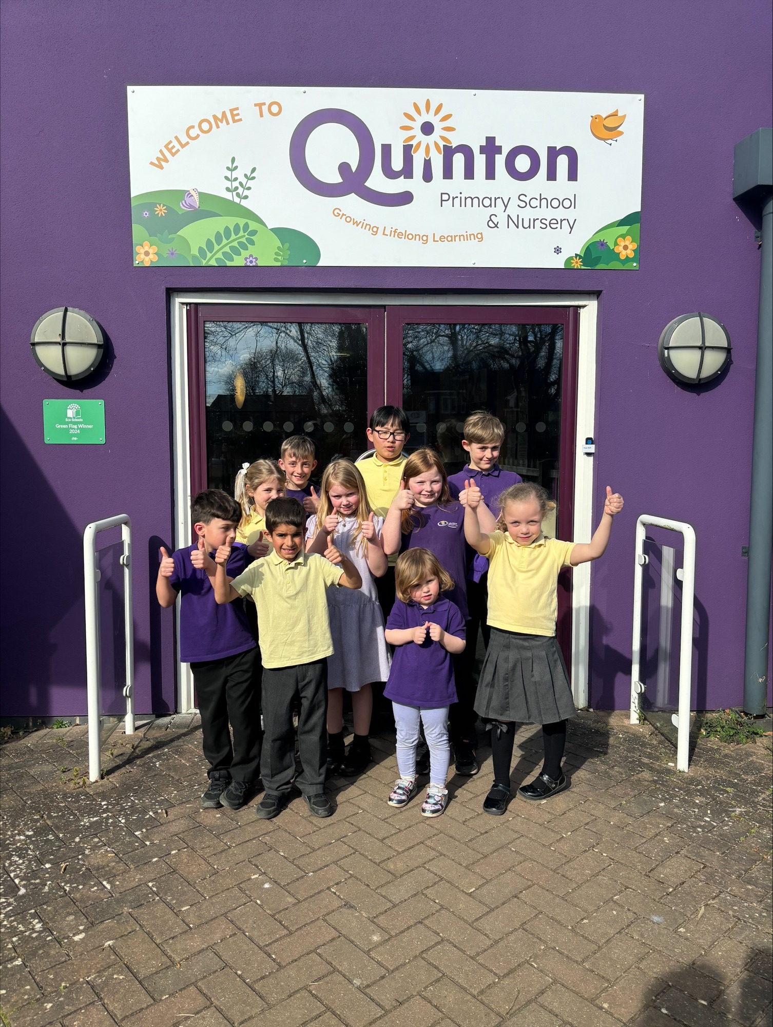
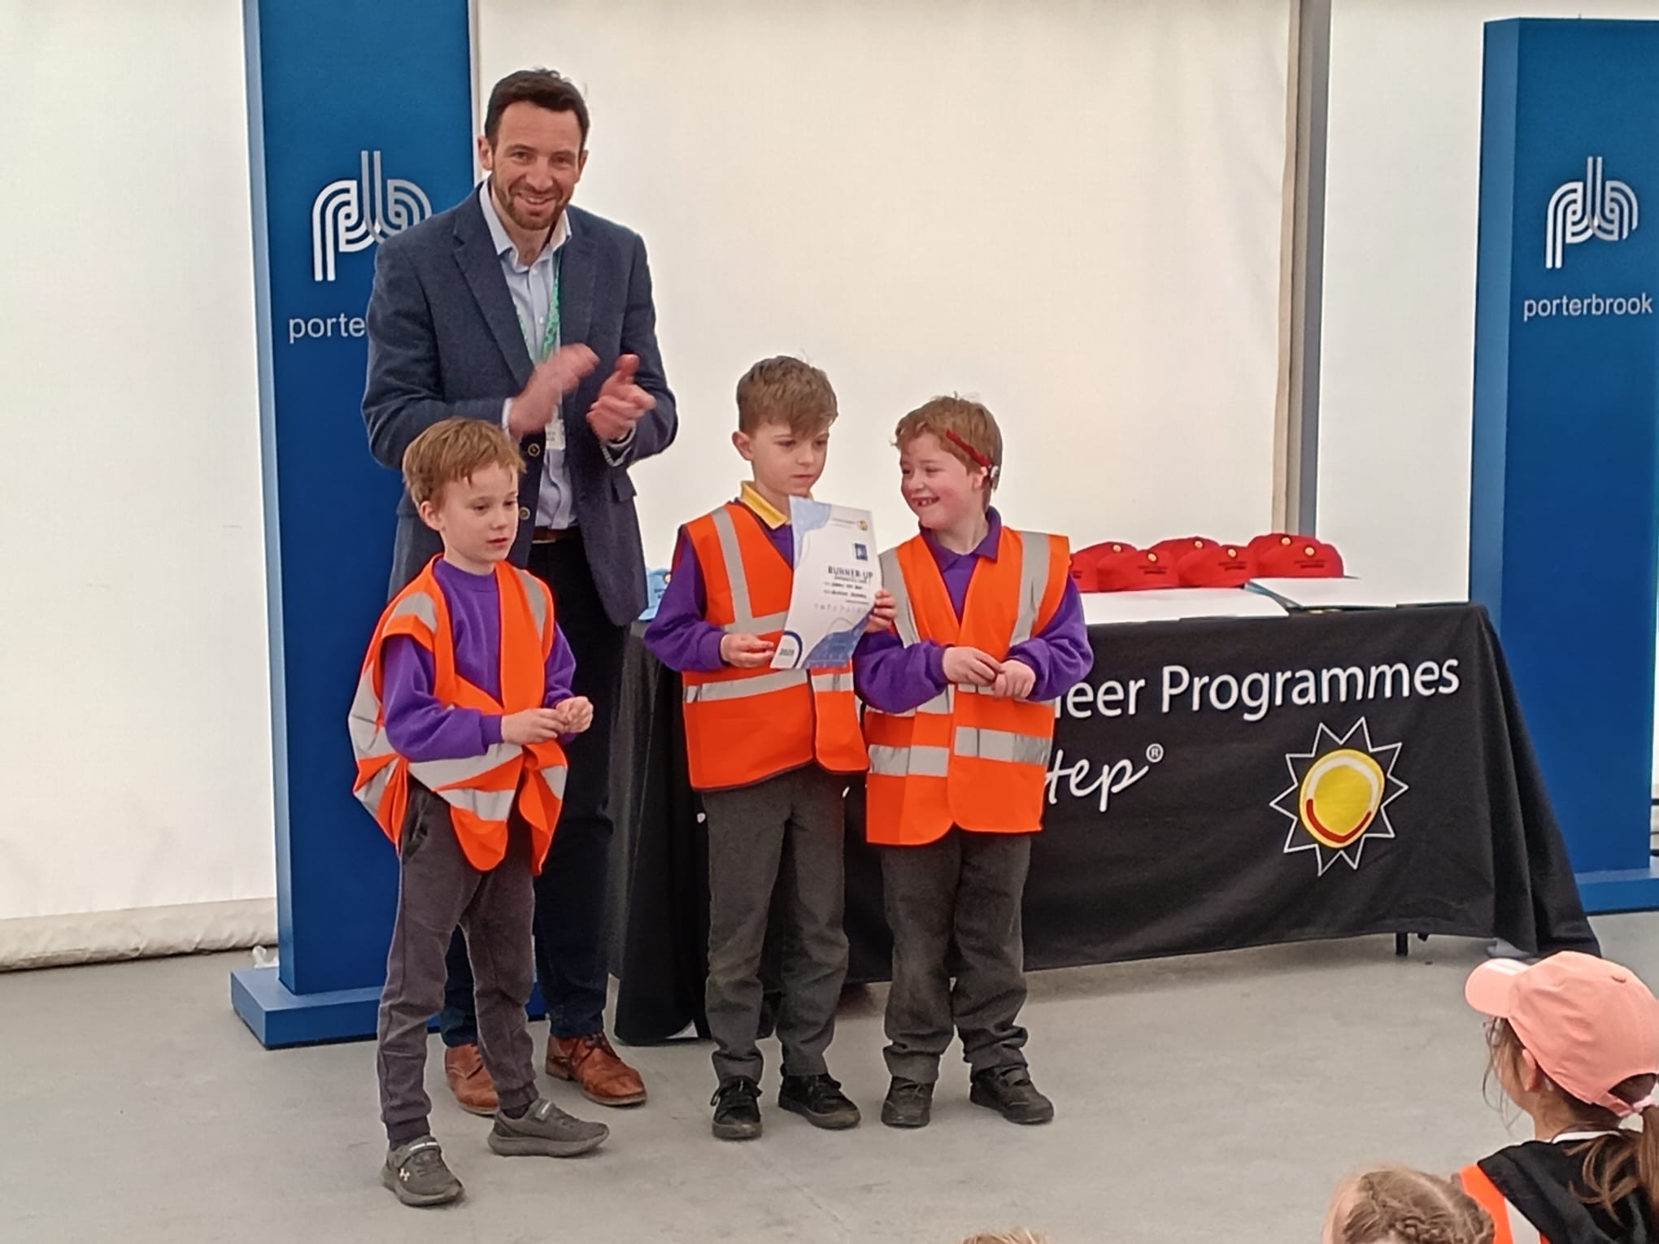
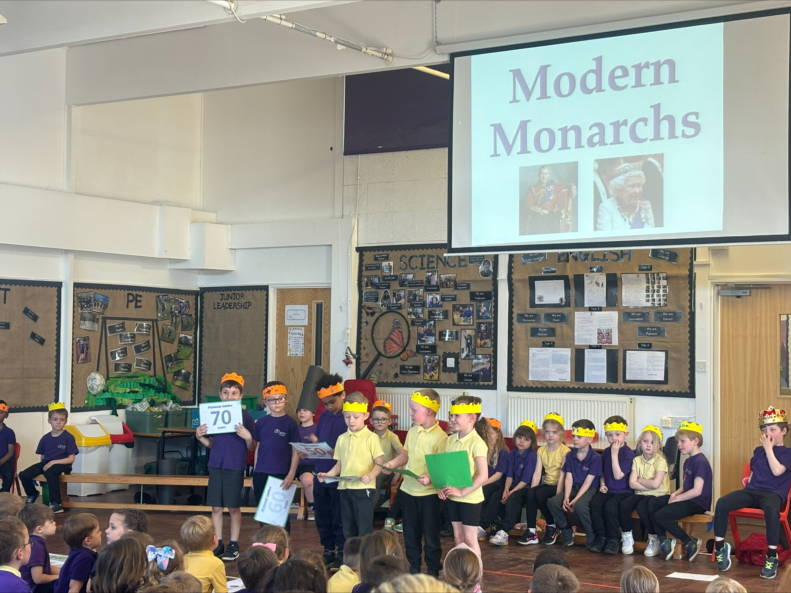
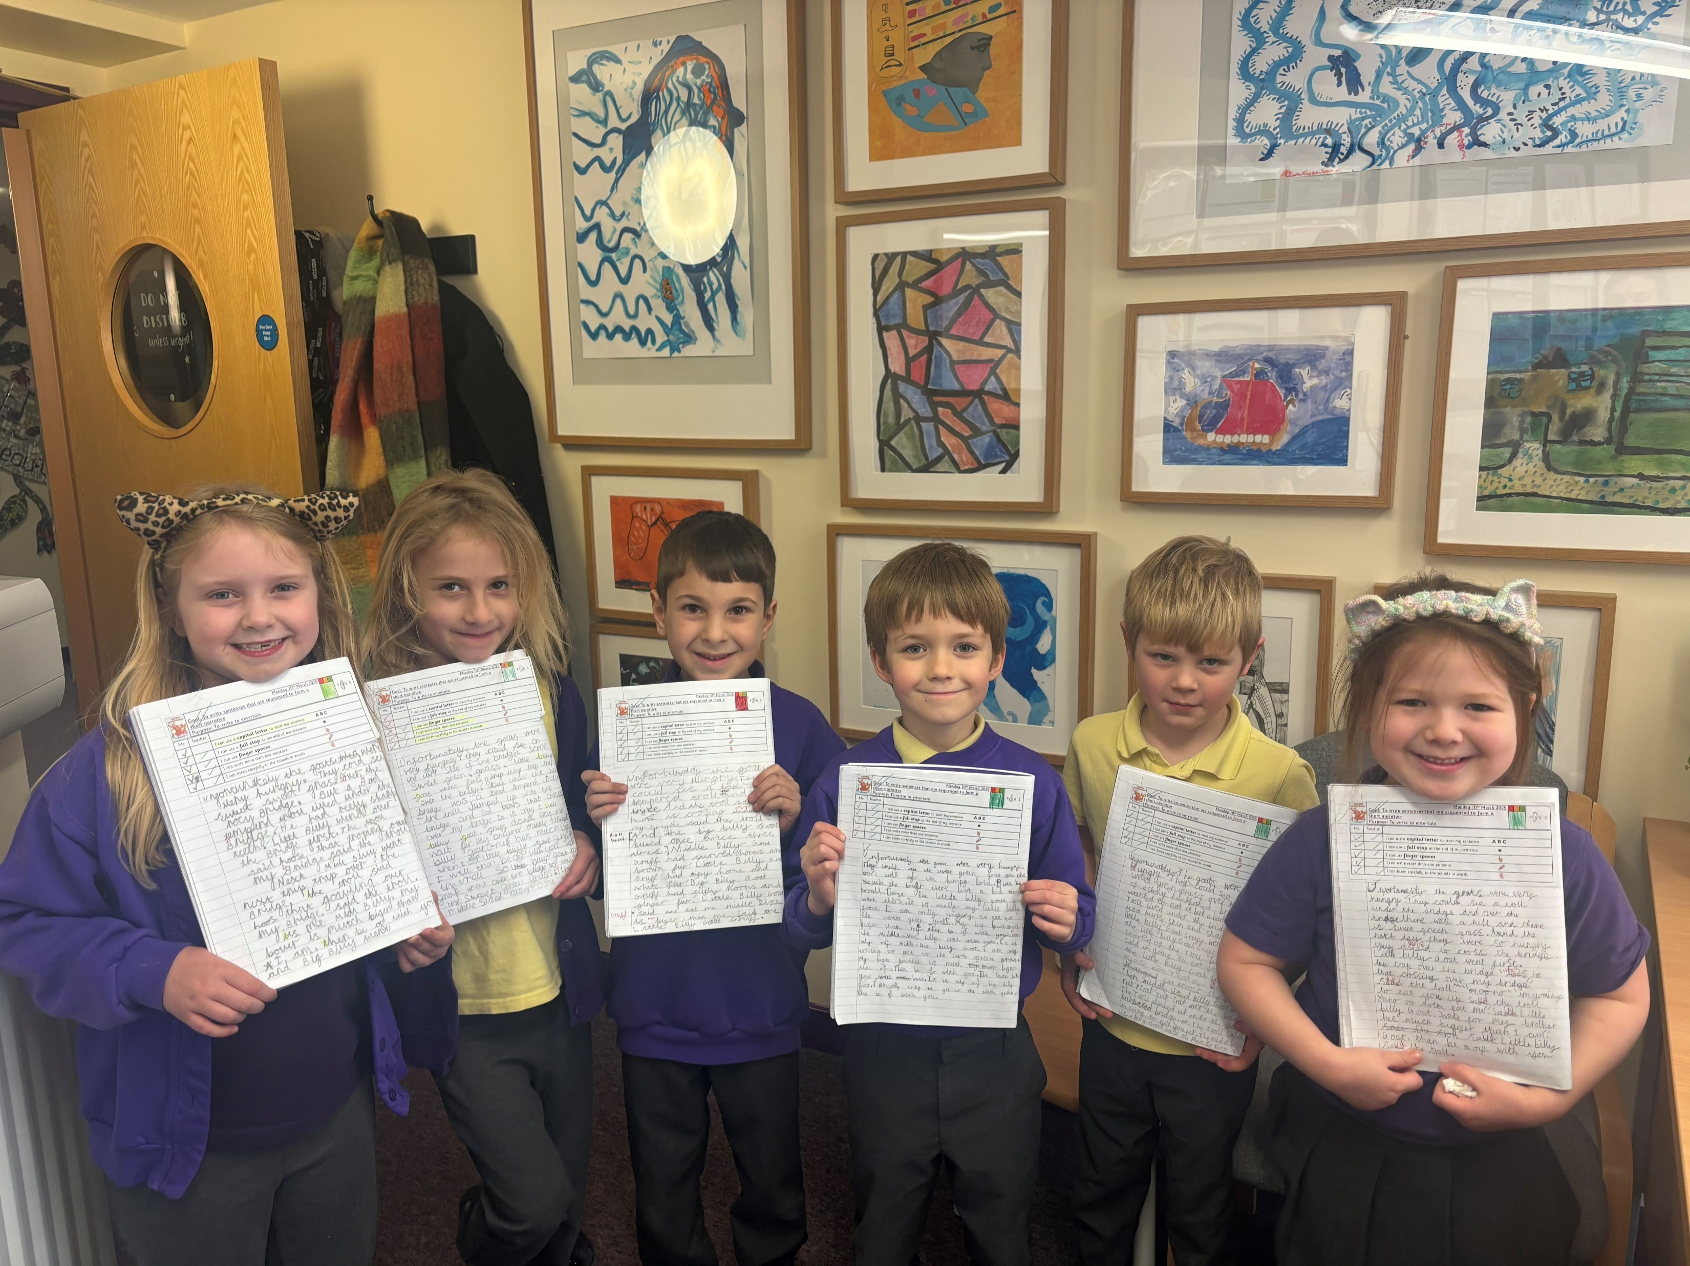
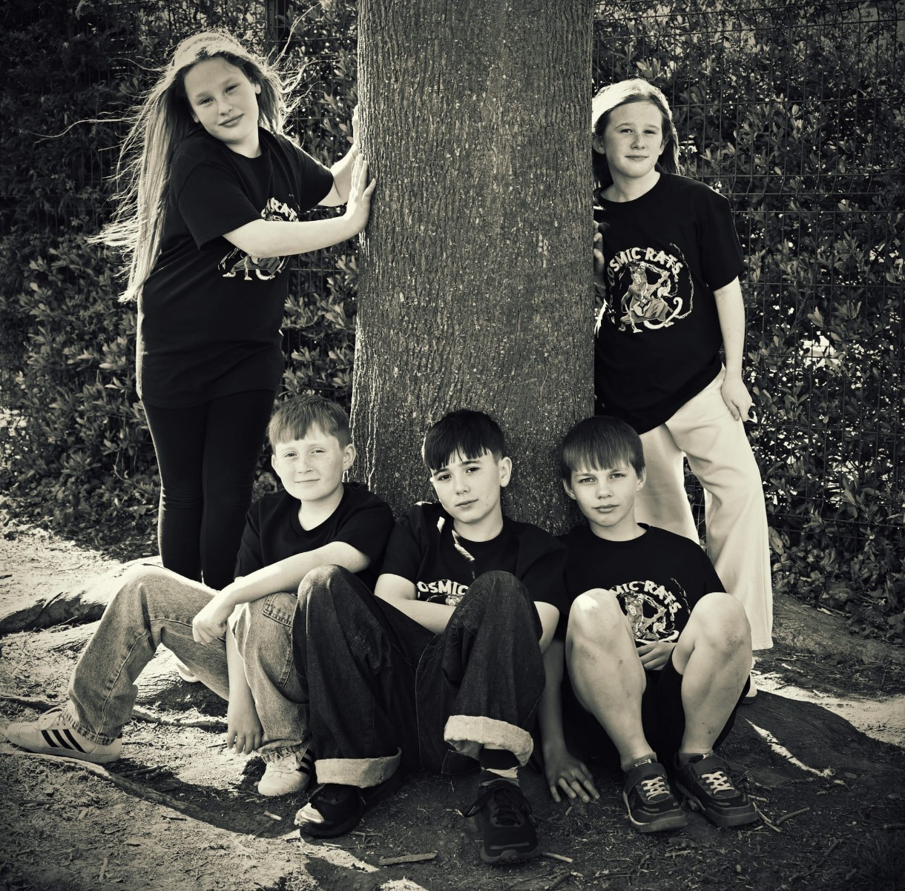
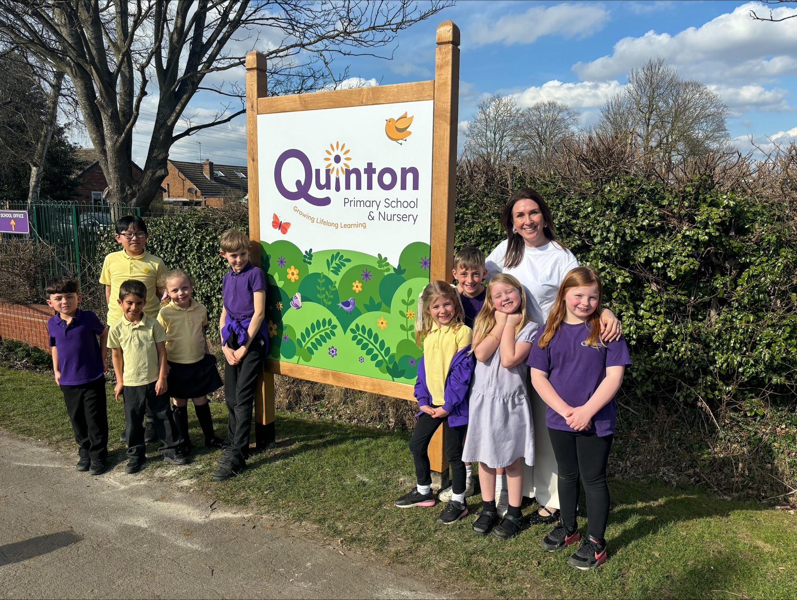
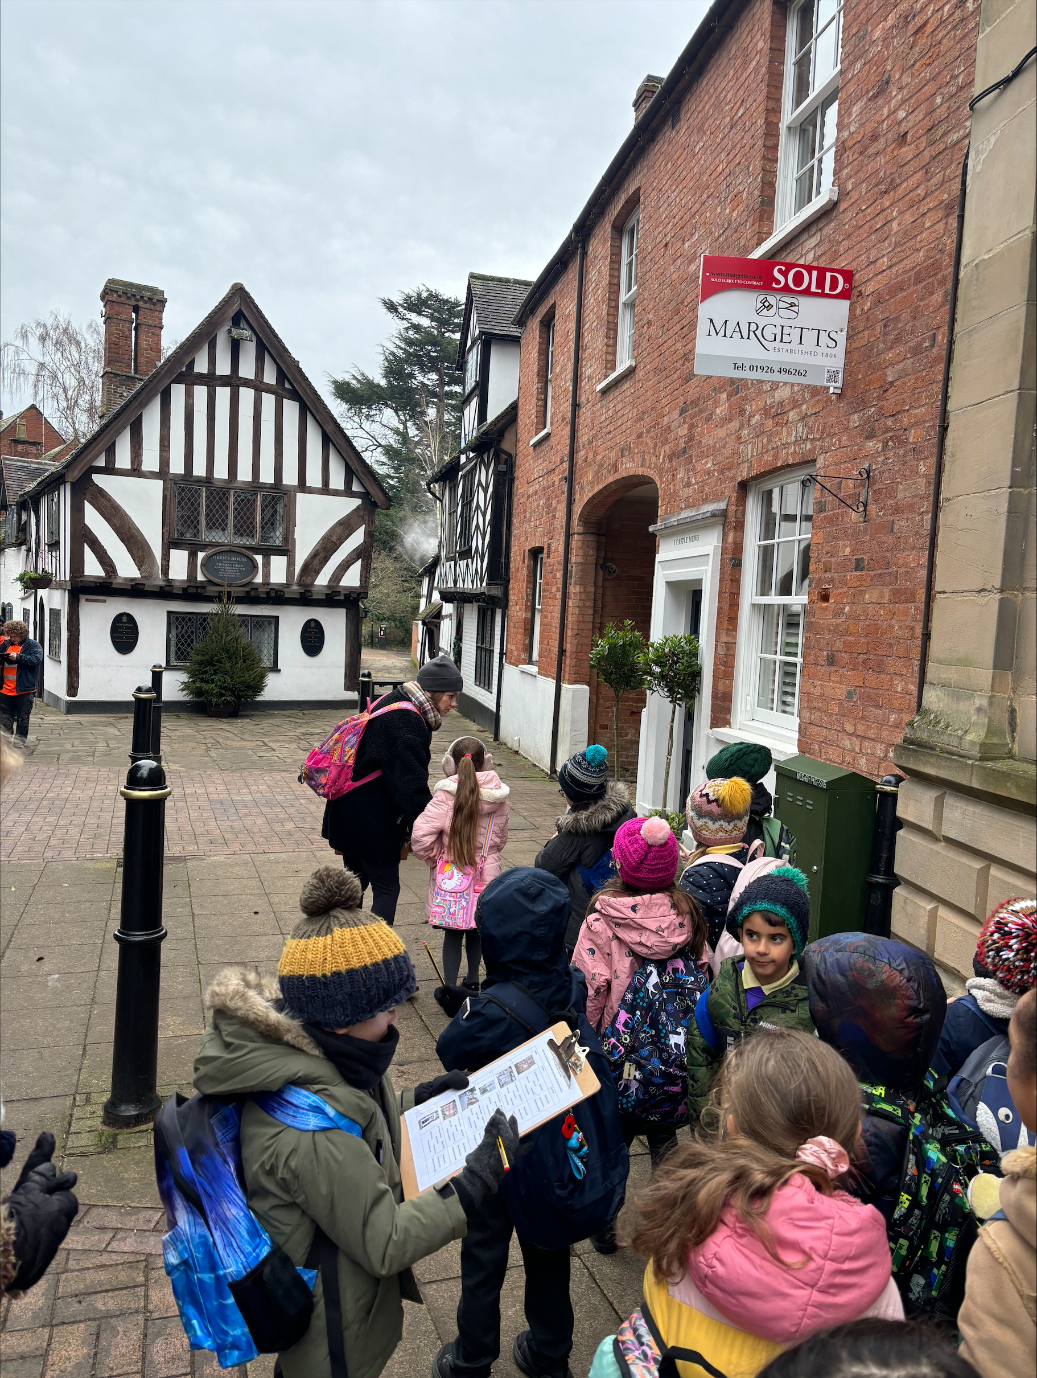
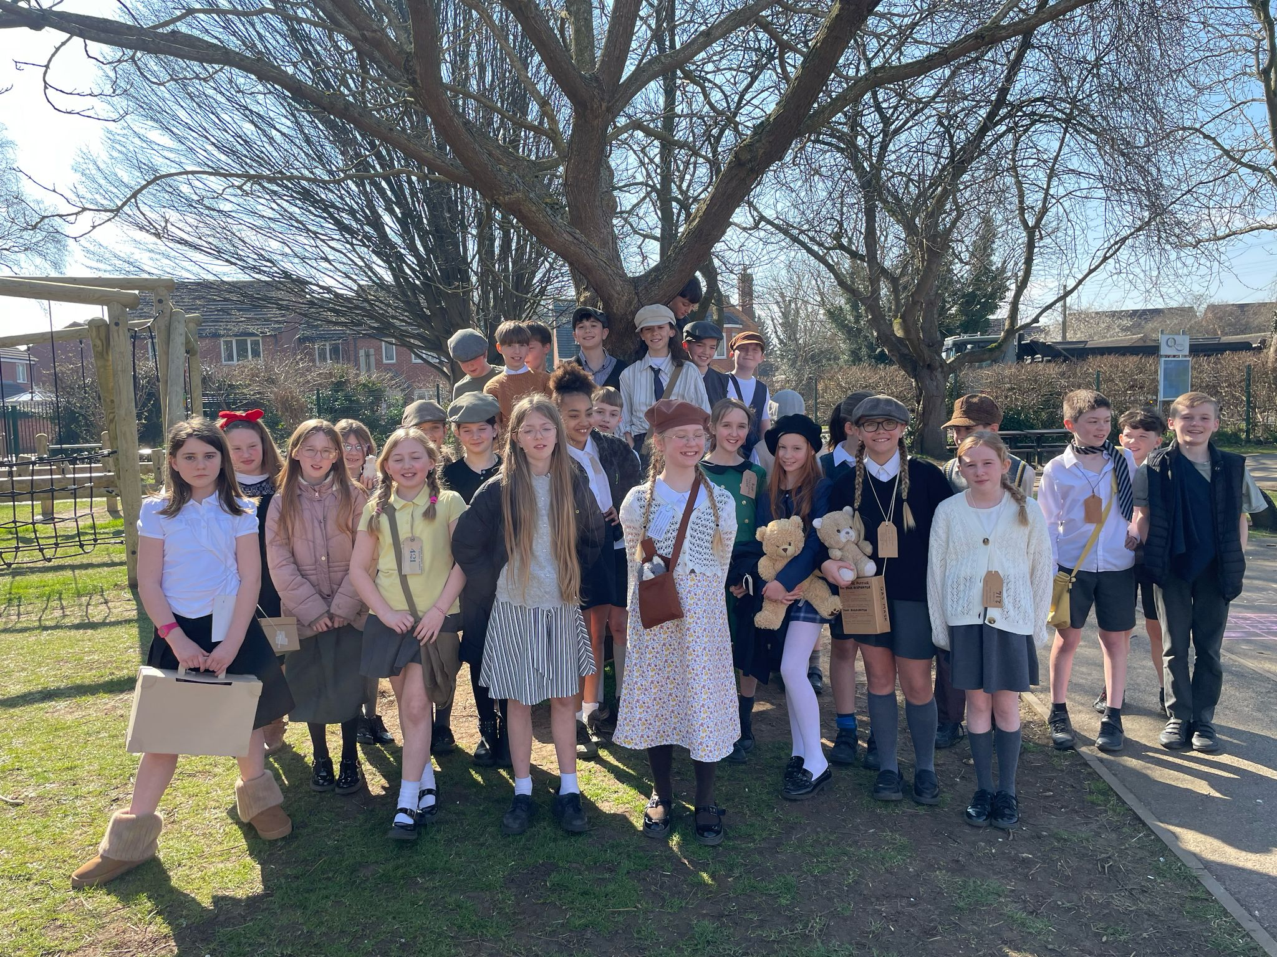

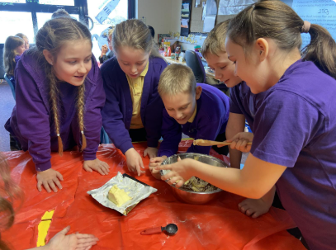
Changes Made Recently
Signage around the school
New external door in Year 2
Wraparound care offer introduced
Wide range of music opportunities now on offer
Wider range of sporting opportunities
Revised swimming system
OPAL programme started
Front playground equipment
New vision and values
Efficient use of Reach More Parents
Quinton Quill
Parent Pay cashless approach
Curriculum/ staffing changes for afternoons
Maths Mastery
Celebration of Learning events/ more parental events
New website
Emphasis on behaviour curriculum
Wider range of opportunities in general- Rail Project/ Young Voices
Interim reports

Slide 9

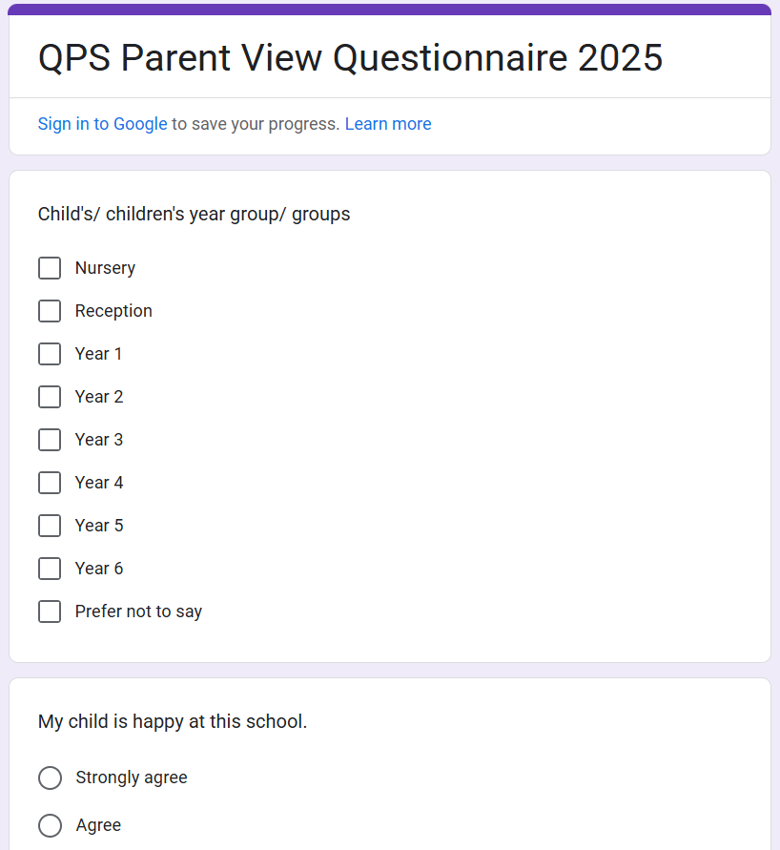
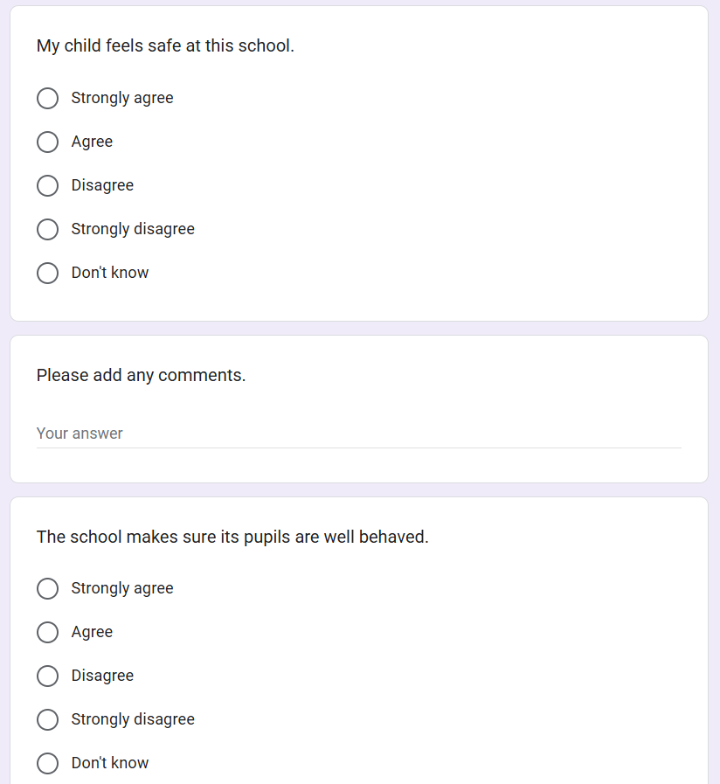
How Can You Help?
Attendance/ punctuality is key
Check RMP/ Quinton Quill regularly
Volunteer – reading, trips, PTA
Keep us informed
Talk to us! Questionnaire coming up
Support children with good sleep and a decent breakfast
Help children become independent and organised learners at home
Be kind!

