Slide 1

Year 5 Curriculum Evening September 2025

Slide 2

Year 5 Team Mrs Kirman– Class Teacher Miss Johnson – Teacher on Fridays Mrs Chambers – Teaching Assistant Mrs Houghton – Teaching Assistant

Slide 3



Year 5: Curriculum
The children experience a varied curriculum at Quinton.
An overview of each topic will be uploaded onto the website each half term.
This will provide you with the curriculum content and objectives that we cover for each subject.
The topics in Year 5 are:
AUTUMN
SPRING
SUMMER
Invaders
(Anglo-Saxons and Vikings)
Text Focus – The fastest boy in the world
The Ancient Maya

Slide 4





Reading
During lessons, the children will have opportunities to read and explore a wide variety of rich literary texts, including:
Class Novels:
Notes:
Alison: Continue to introduce key texts in relation to the curriculum of previous slide.

Slide 5
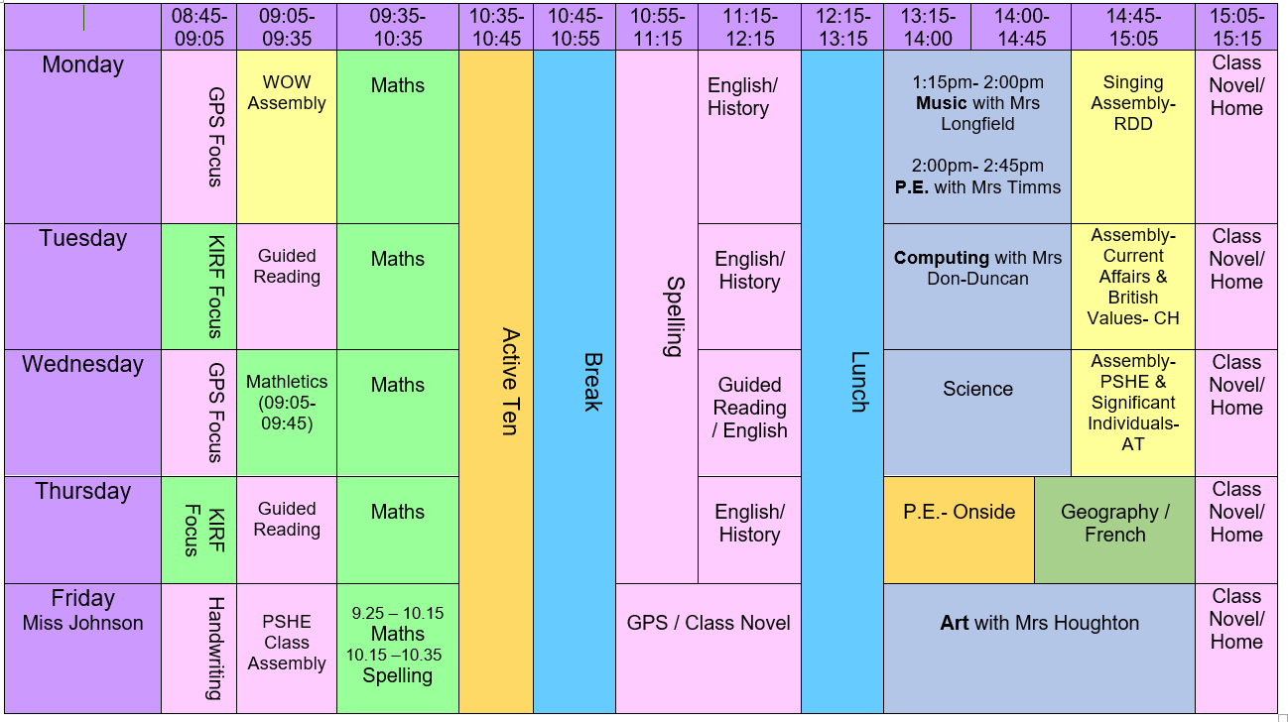
Timetable
Notes:
Explain the EOY expectations for Year 6 and emphasise key points given school context (i.e. handwriting is vital for expected standard and GDS).

Slide 6
Homework Expectations
SPELLING
At the start of each half-term, your child will receive a Spelling Overview.
This overview will include:
o All the spelling lists for the half-term.
o The spelling focus or pattern for each week.
Weekly Tests: Spelling tests will take place every Monday in class.
DAILY READING
We expect every child to read daily at home.
How to support your child:
Listen to them read as well as them reading independently.
Encourage your child to record their reading in their reading record at least three times per week.
Notes:
Explain the EOY expectations for Year 6 and emphasise key points given school context (i.e. handwriting is vital for expected standard and GDS).

Slide 7
Homework Expectations
MATHS
Mathletics books have been sent home and are due back in each Monday, so that we can check that we have them all before marking on the Wednesday.
The questions are to be answered independently by the by the children. If you do need to provide support, then please indicate this next to the question with a star so that we know where the children need further support in school.
Children who have not completed their Mathletics homework will be able to attend homework club on a Tuesday lunchtime.
Key Instant Recall Facts (KIRFs) practise
Your child will bring home a KIRF sheet with details of the half-term's maths facts to learn. Please practise these facts with your child. The facts will then be tested in the last week of each half-term.
Times Tables Rock Stars (Years 3-6)
We recommend that your child uses Numbots/ Times Tables Rock Stars regularly to improve their mental maths skills/ times tables skills.
You can access it using the logon which your child will be given at school.
Notes:
Explain the EOY expectations for Year 6 and emphasise key points given school context (i.e. handwriting is vital for expected standard and GDS).

Slide 8
Exciting Opportunities
Bikeability
Geography fieldwork trip
Class Assembly
Trip to Shakespeare’s Birthplace (guides for the day)
Rehearsal Room Writing Programme with Royal Shakespeare Company
(A programme designed to improve pupils’ writing ability, their enjoyment of writing and their belief in their writing ability).
Maya DT day
Anglo-Saxon and Viking Trip (Spring Term)

Slide 9

Online Safety
The vast majority of children in school will be using the internet for some sort of online gaming or social networking.
Gaming apps on phones or tablets often allow children to communicate with each other, and strangers, online.
If school staff become aware of children playing games that are not age-appropriate, it is their responsibility to report it as a safeguarding concern.
All children at Quinton benefit from a proactive PSHE curriculum, including many lessons about online safety suited to their age group.

Slide 10
Online Safety – How can you help?
Ensure that children are using child-friendly versions of search engines and YouTube.
Use parental controls and filters.
Have an ‘open access’ policy with any devices. Children should not feel like communication online is a private conversation.
Discuss the impact cyberbullying can have and what it may look like.
Discuss the risks image sharing – photo manipulation.
Report any Online Safety concerns to your child’s class teacher as soon as possible.

Slide 11
Online Safety
Useful websites with support for parents
NSPCC
https://www.nspcc.org.uk/keeping-children-safe/online-safety/
Internet matters
https://www.internetmatters.org/?gclid=EAIaIQobChMIi5mK6q6y-gIVTbDtCh3QOA8hEAAYASAAEgIMIPD_BwE
CEOP
https://www.thinkuknow.co.uk/parents/
Safer Internet
https://saferinternet.org.uk/guide-and-resource/parents-and-carers

Slide 12
How can you get involved?
Celebration of Learning
Class Assembly
Supporting with homework
Special days throughout the year – DT sewing day, etc
Parent readers
PTA events

Slide 13
Questions? Thank you for attending

