Slide 1

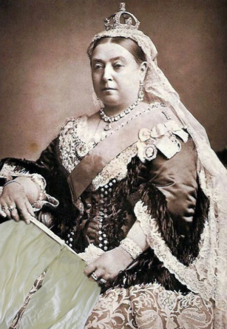
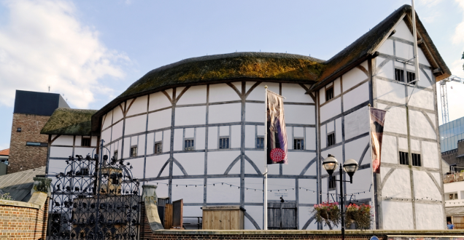
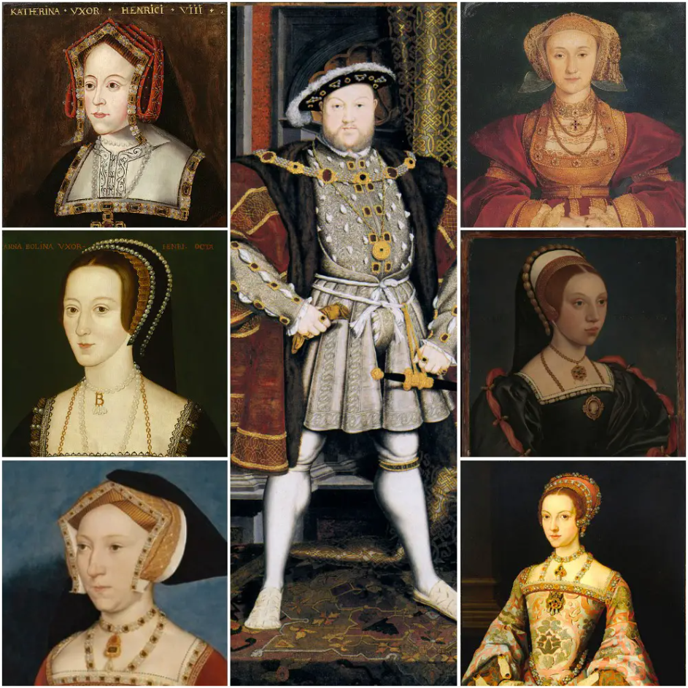
Year 5 Knowledge Organiser Spring Term
The Tudors
TERMS Key Vocabulary
Tudor | The Royal family that ruled England until 1603
Monarch | A king or Queen who rules a country
Reign | The period of time a monarch is on the throne
Heir | A person who will inherit the throne or title
Throne | The ceremonial seat of the King or Queen
Palace | A large and impressive home for royalty.
Court | The people who live and work around the monarch
Nobel | A person from a high social class with wealth or power
Portrait | A painting or drawing of a person
Succession | The order in which people inherit the throne
COMPARE Similarities and Differences
Houses: Homes were made from wood and wattle and daub with thatched roofs.
Food: The wealthy ate meat-heavy meals whilst the poor relied on grains, dairy and vegetables.
Writing: Quills (pens made from feathers) were used alongside homemade ink. Wooden tablets covered with wax were also used.
Buildings: The Globe, The Tower of London, Hampton Court Palace
Way of life: Heavily influenced by class, faith and a reliance on faming.
Tools: Barber surgeon tools, spinning wheels cannons!
Animals: Relied on for farming and agriculture. The wealthy used animals to show off their riches and for novelties in the court. Anne Boleyn kept a pet monkey.
SOURCES How We know about the Tudors
Written records became very popular
Many physical artefacts have survived
Society was highly documented, especially
through personal diaries
Portraits became very popular, especially
amongst the rich nobles.
Literature and drama – Shakespeare!
Many building are still standing today

Slide 2
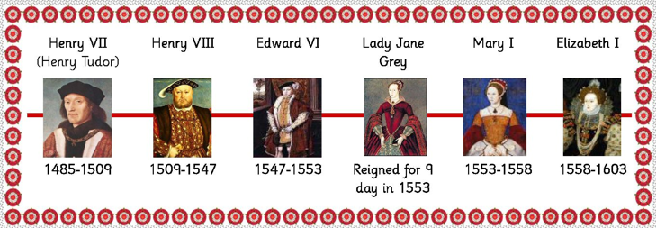
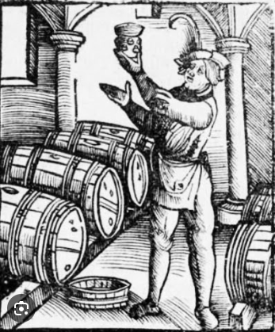
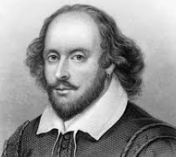
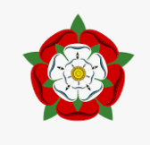
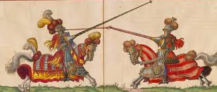
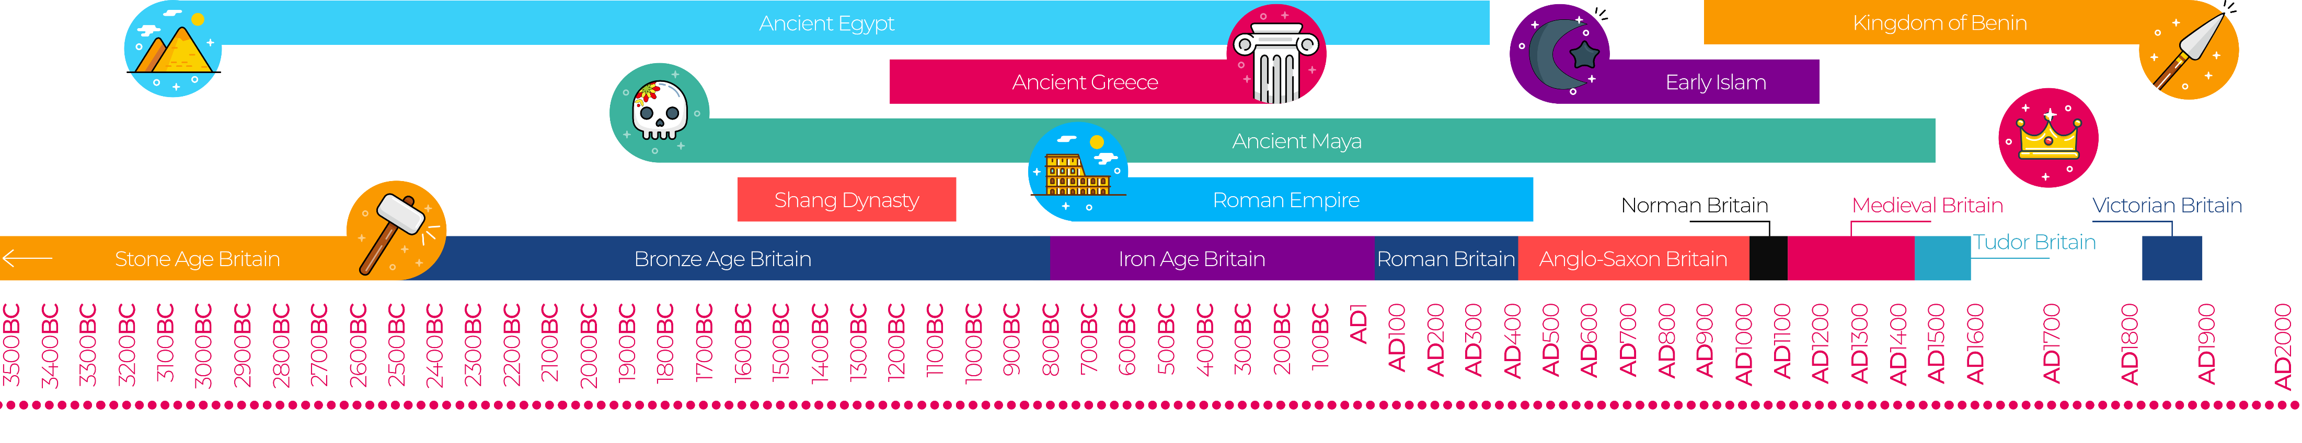
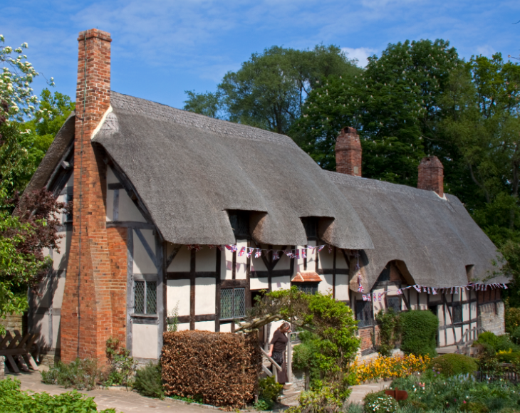
Extra Facts
Black teeth were fashionable – Queen Elizabeth loved sugar so much, her teeth turned black, as a royal, people copied her, deliberately staining their teeth black!
Sir John Harington invented the first flushing water closet.
Tudors didn’t use forks – just a knife and their fingers
It was illegal to wear purple and was strictly reserved for royalty.
Water was contaminated so it was safer to drink beer.
Doctors were expensive, Tudors made their own remedies – including a face cream made from mouse bones!
The phrase ‘Knock knock! Who’s there was coined by William Shakespeare.
In 1536 Henry VIII has a serious jousting accident. He fell off his horse and got trapped beneath the horse. He was knocked unconscious for a few hours.
Jousting was a popular sport in the Tudor times.
CHRONOLOGY How Long did the Tudors reign?
The Tudors reigned from 1485 – 1603
Henry VIII – 1509 – 1547 – Reigned for 38 years, marrying six times during his reign.
Edward VI – 1574 – 1553 – Henry’s only son. He was crowned but died age 15.
Lady Jane Grey – 1553 – ‘The Nine Day Queen’
Mary I – 1553 – 1558 – Henry VIII’s first born child. She restored Catholicism in England
Elizabeth I – 1558 – 1603 – Henry VIII’s second daughter. She reigned for 45 years, established the Church of England and died without any heirs, ending the Tudor dynasty.
King James VI – 1603 – 1625 – He was already King of Scotland from 1567, he was crowned at 13 months old

